Slide 1

ECOSCAN
Plant Disease Detection System

Slide 2
AGENDA
01.
02.
03.
10.
Improvements
Project Description & Problem Statement
Team Agreement & Personas
Burn down Chart & Retrospective
04.
05.
06.
11.
Application screenshots and Demo
MVP And Tools Used
Machine Learning Algorithm
Diagrams
07.
08.
09.
12.
Sprint Recap & Project backlog
User Stories & Acceptance Criteria
Test Cases & Sprint backlog
API’s and Technical Paper

Slide 3
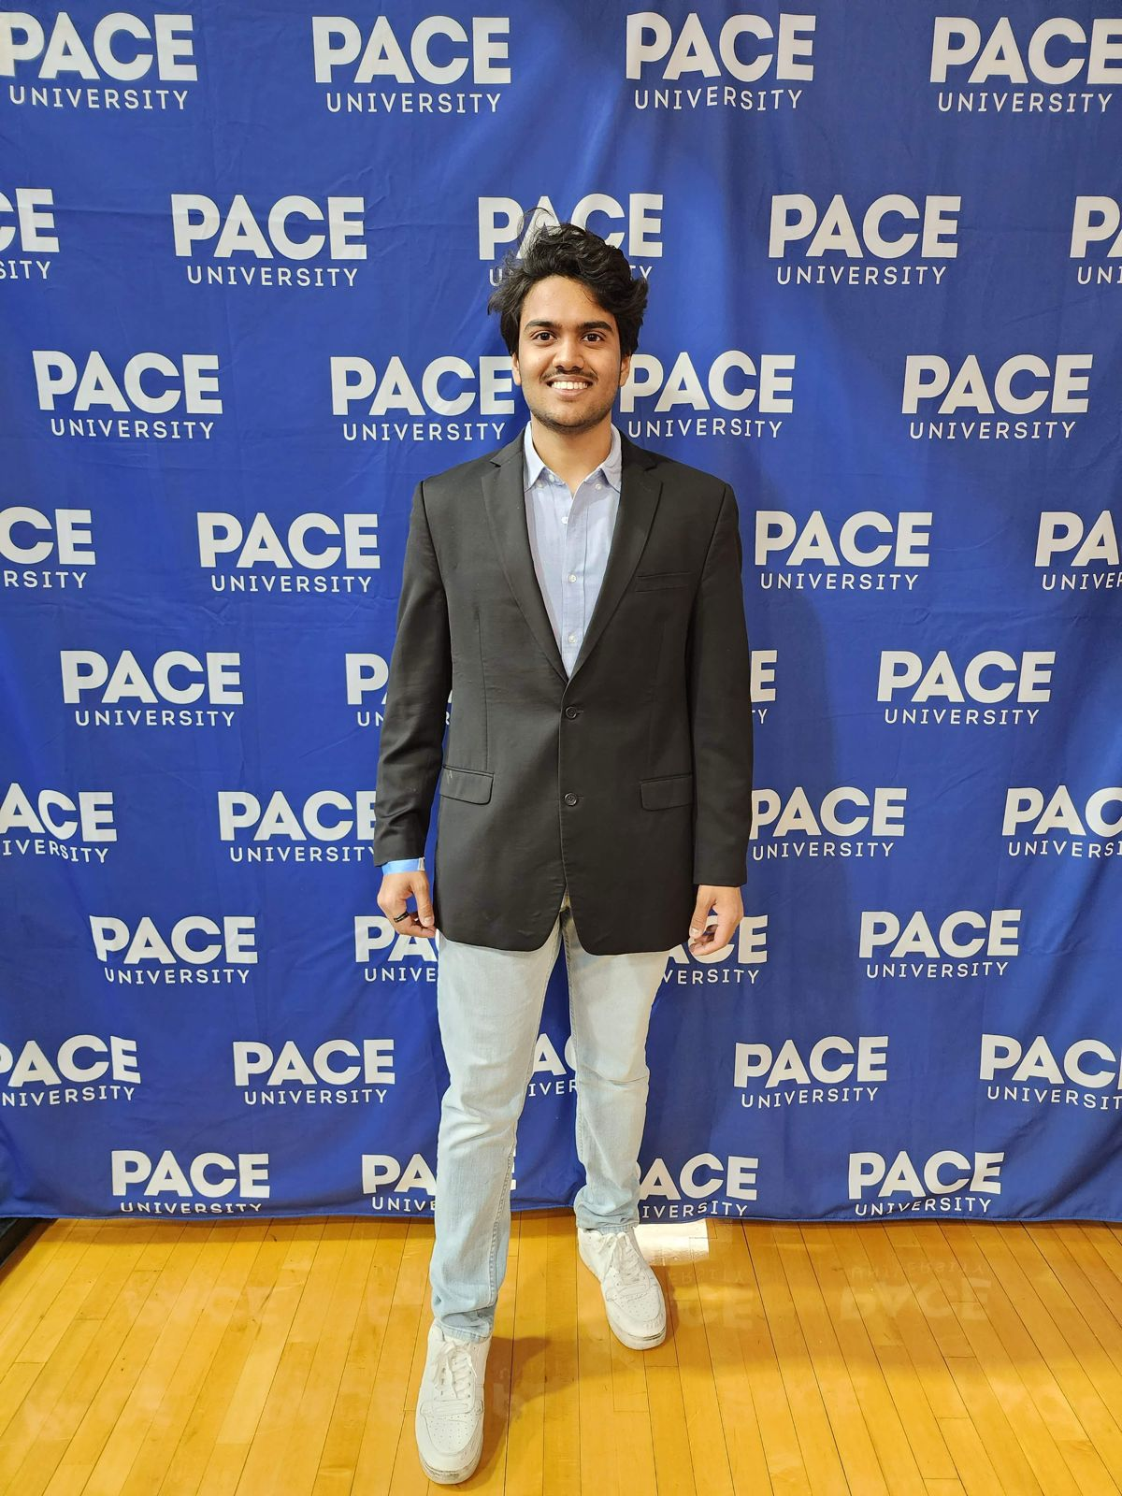
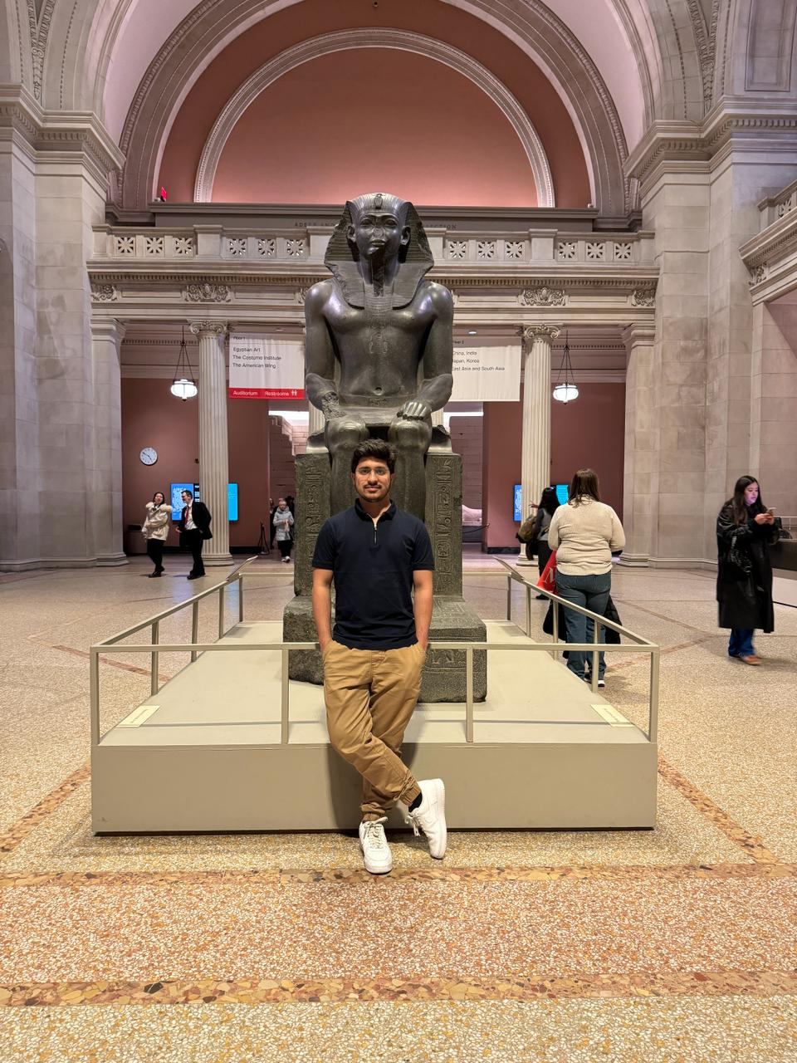
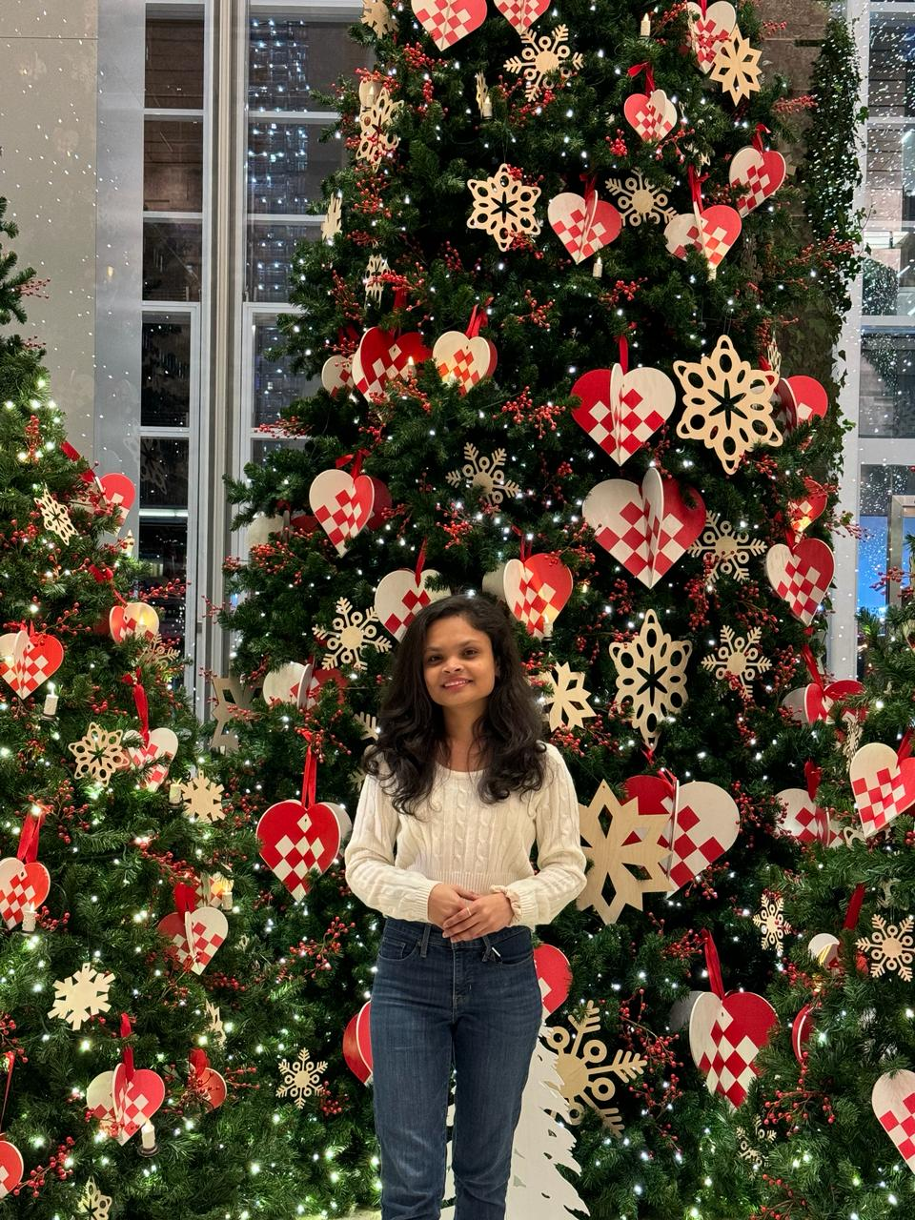
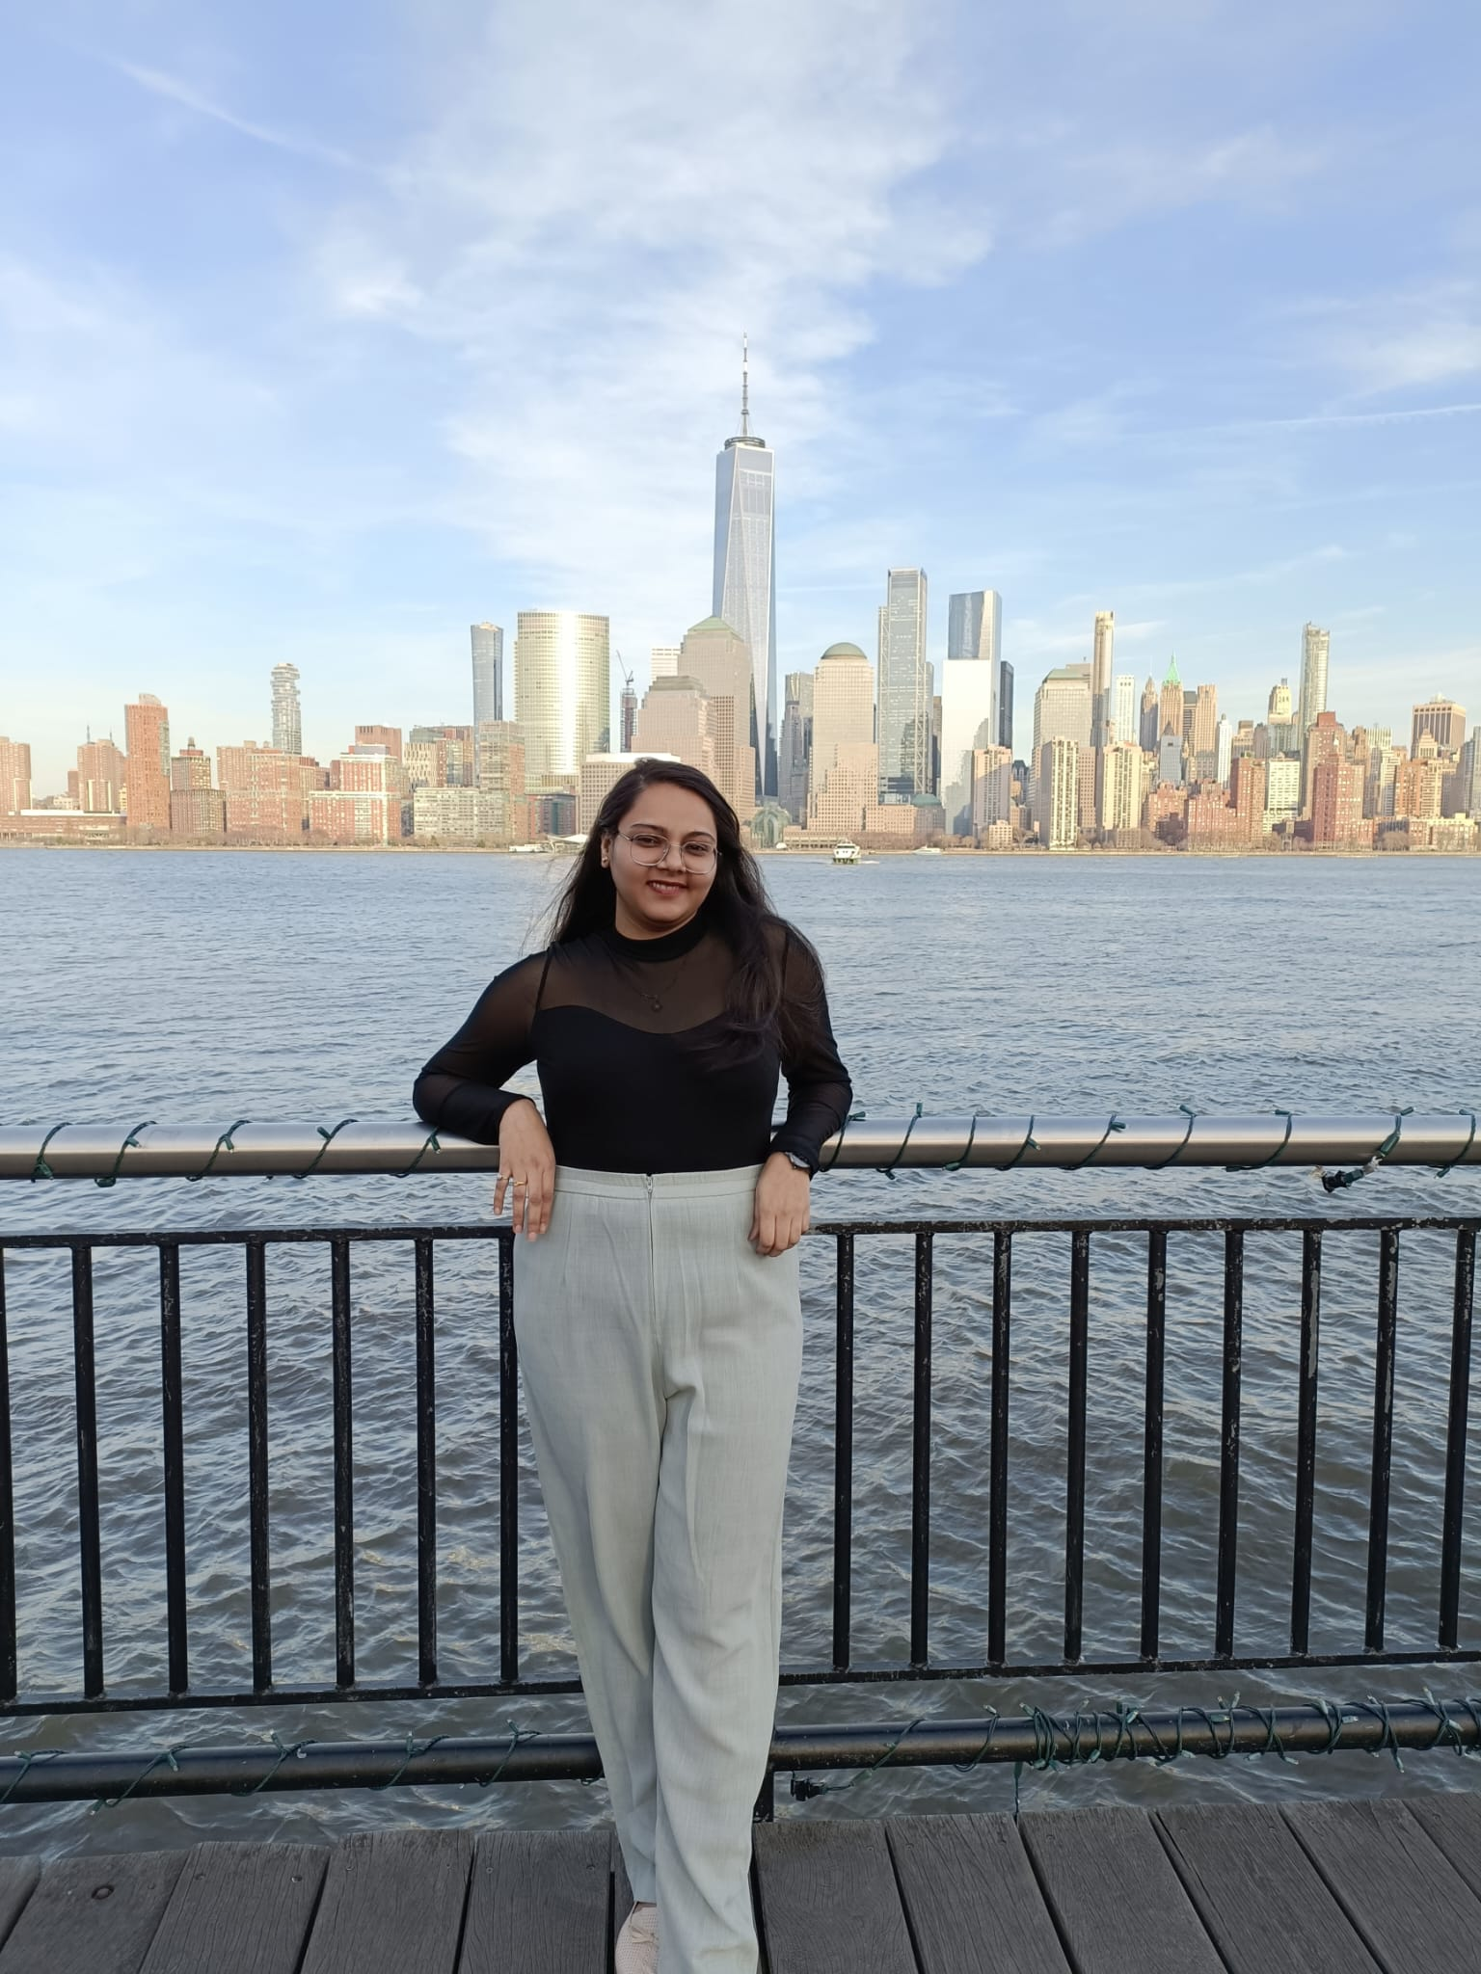

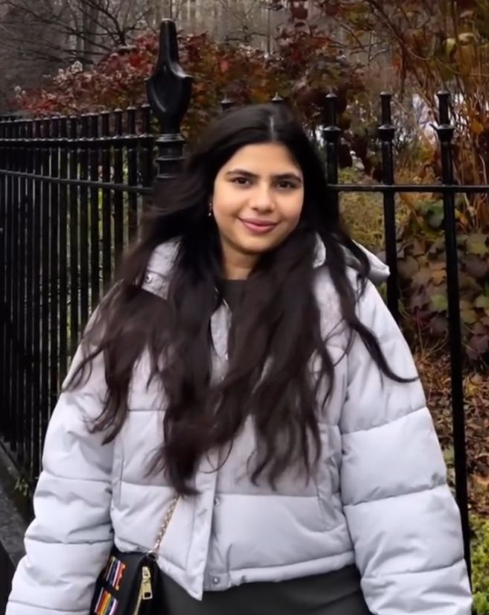
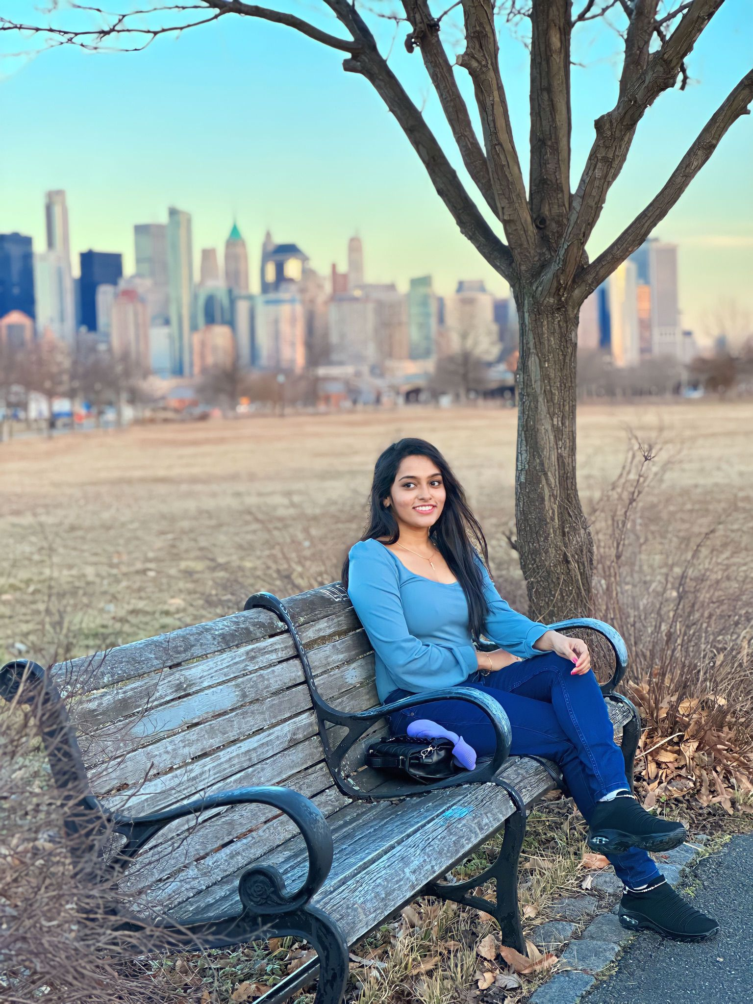
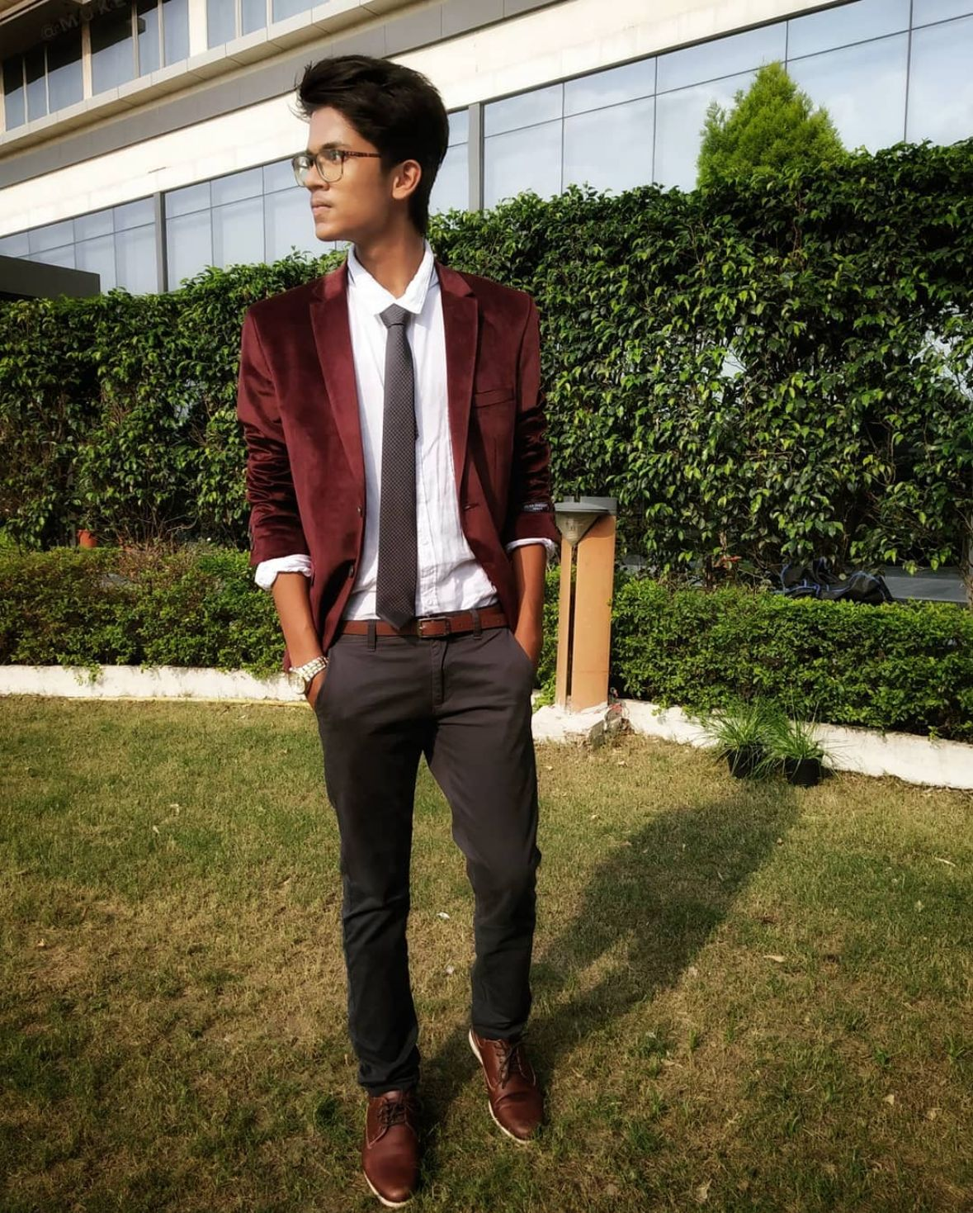
Our Team
Rudra Chobe
Scrum Master / Developer
Omkar Gurav
Developer
Shriya Haral
ML Developer
Ritika Chougala
Developer
Lokeshwar Anchuri
Developer
Niyati Ghagada
Developer
Uma Maheswari Addala
Developer /Tester
Mukesh Suddala
Developer/Quality Assurance

Slide 4
IMPROVEMENTS MADE FROM PROFESSOR’S FEEDBACK
Made changes in Sprint Recap
Updated the Product Backlog Slide
Fixed the User Stories and Story Points
Updated the Acceptance criteria's
Fixed Test cases along with user story ID and
Corrected the metrics
Included demo in the Presentation
This indicates the changes made

Slide 5

PROBLEM WHICH WE ARE ADDRESSING

Slide 6
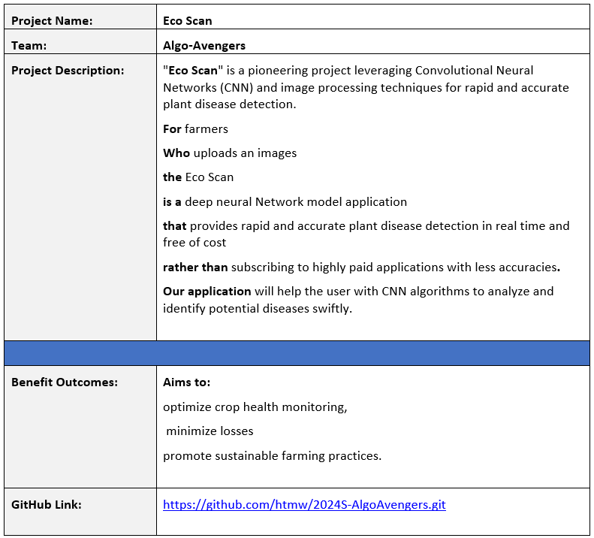
Project Description

Slide 7
Problem Statement
The agriculture sector plays a crucial role in sustaining global food security, and plant diseases pose a significant threat to crop yield and quality. Identifying and managing these diseases in a timely and accurate manner is essential for ensuring food production. However, the current methods of plant disease detection often rely on visual inspection by experts, leading to delays in diagnosis and sometimes inaccurate assessments. Additionally, the increasing complexity and variability of plant diseases make it challenging for traditional methods to keep pace with emerging threats. There is a pressing need for advanced and automated plant disease detection systems that can provide rapid, reliable, and precise identification of diseases, enabling farmers to take proactive measures to protect their crops and enhance overall agricultural productivity.

Slide 8
Problem Statement
Furthermore, the economic impact of plant diseases on farmers and the agriculture industry is substantial, with losses stemming from reduced yields, increased use of pesticides, and the potential spread of diseases to neighboring crops. In the face of climate change and global trade, the dynamics of plant diseases are evolving, necessitating a more adaptive and technology-driven approach to diagnosis and management. The development of efficient and scalable plant disease detection solutions that leverage advancements in artificial intelligence, machine learning, and image processing is paramount. By addressing these challenges, we can empower farmers with timely information, minimize crop losses, promote sustainable farming practices, and contribute to the overall resilience of the agricultural sector in the face of emerging plant health threats

Slide 9
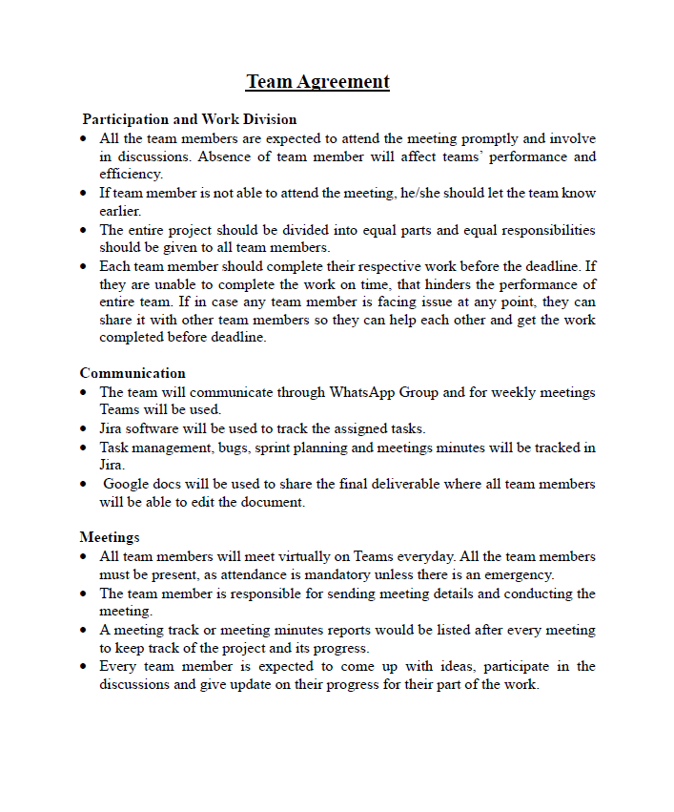
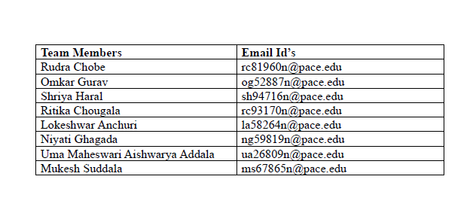
TEAM AGREMENT

Slide 10
PERSONAS

Slide 11
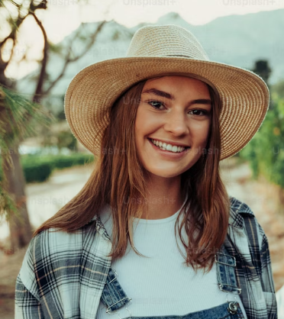
PERSONAS
Ava, the progressive farmer is deep-rooted in the rhythm of the seasons, guiding her farm through cycles of growth and harvest. Yet, she's no stranger to the harsh realities of plant disease and its impact on yield and sustainability. Faced with the complexities of organic farming, she's seeking innovative solutions to protect her crops without resorting to chemical interventions.
Interests
Aside from her passion for sustainable farming, Ava is interested in the latest agricultural technologies that can help optimize organic farming practices.
Frustration
The unpredictability of plant diseases and the limited effectiveness of conventional organic methods in rapid detection and management are her main obstacles.
Goals
Ava is determined to integrate cutting-edge technology into her farming practices to boost productivity while adhering to organic principles.
Name: Ava
Age: 28
Location: Ames, Iowa
Occupation: Owner and
operator of an organic farm
Income: $66,000/annually
Family: Married

Slide 12
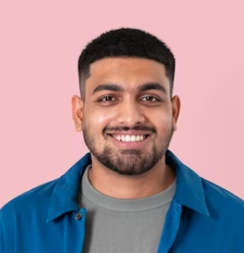
PERSONAS
Raj is a visionary in his field, constantly coding and testing the limits of artificial intelligence to serve the earth's farmers. He sees the potential in every line of code to revolutionize traditional farming practices. However, he struggles to find real-world test beds for his algorithms, which are necessary to refine and tailor his solutions to the nuanced needs of agriculture.
Interests
Participating in Hackathons, Coding contests etc.
Practicing yoga and mindfulness
Emerging tech in AI.
Frustration
Access to diverse agricultural data and the hesitancy of the farming community to adopt new technologies are his primary challenges.
Goals
To develop a robust platform that can adapt to various agricultural contexts and improve farm resilience against diseases.
Name: Raj
Age: 30
Location: New York City, NY
Occupation: AI Software
Engineer in Agri-Tech
Income: $120,000/annually
Family: Single

Slide 13
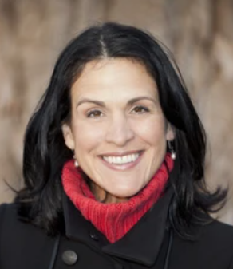
PERSONAS
Claire is a bridge between the agrarian world and the halls of legislation, tirelessly working to shape policies that promote ecological stewardship and technological innovation in farming. She understands the urgency of sustainable agriculture in the face of climate change but is often met with resistance from policymakers reluctant to prioritize or fund these initiatives.
Interests
Enjoys reading about global economic trends.
Organizes educational workshops on sustainability.
Enjoying weekend family outings
Frustration
Her challenge is to navigate the complex political and economic landscapes to secure support and funding for agricultural technology initiatives
Goals
To influence the adoption of sustainable agriculture policies that support and encourage the use of advanced technologies like "Eco Scan."
Name: Claire
Age: 52
Location: Brussels, Belgium
Occupation: Environment Policy Advisor
Income: $70,000/annually
Family: Married

Slide 14
MINIMAL VIABLE PRODUCT

Slide 15
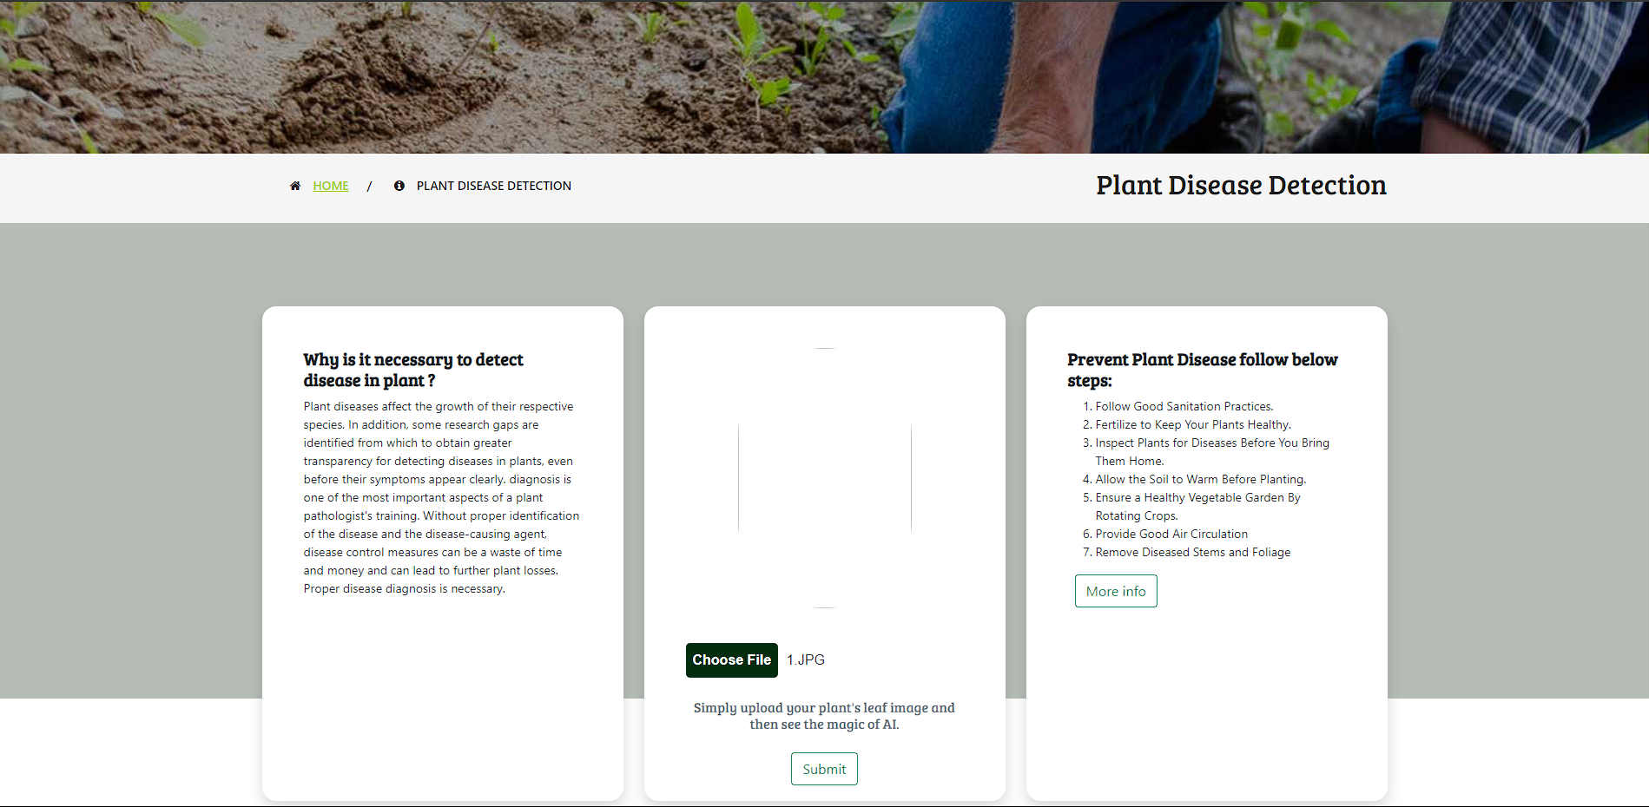
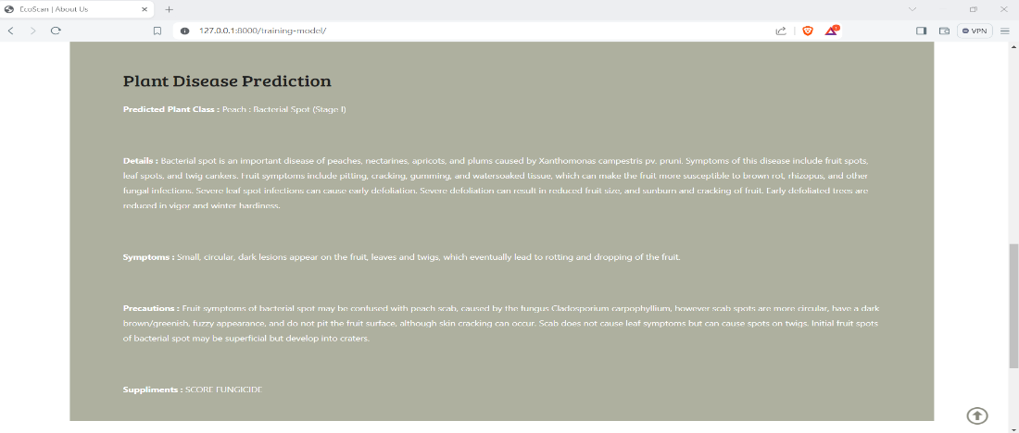
MVP
DISEASE DETECTION PAGE
- A user-friendly interface allowing users to upload images of plant leaves for disease detection, promoting ease of use and accessibility.
- Presentation of detected disease name, stage, description, precautions, and recommended supplements based on the uploaded image.
- An informative section explaining the importance of detecting diseases in plants. This could include preventing crop loss, maintaining agricultural productivity, and ensuring overall plant health.
- Clear and concise steps outlined to prevent plant diseases. This may include practices such as regular inspection, timely treatment, and maintaining optimal growing conditions.
- Know Why is it necessary to detect disease in plant ?
- Check Prevent Plant Disease steps.

Slide 16
TOOLS AND WHERE THEY ARE USED

Slide 17










TOOLS AND LANGUAGES
Python
Numpy
OpenCV
Keras
CSS
JIRA
TensorFlow
HTML
Visual Studio
GIT

Slide 18



WHERE ARE THEY USED?
Front End
HTML, CSS: Used for building our website
Visual Studio: For Front end coding
Figma: Used for Designing (Design Interface)
Back End
Keras, Numpy , Tensorflow: ML Libraries used for model building
Python: Used for programming ML Models
Open CV: For object detection
Django : To connect with Front end
Management
JIRA : Planning and workflow
Teams : Daily meetings
WhatsApp : Daily communications
Git : For Source code management

Slide 19
Machine Learning Algorithm

Slide 20
MACHINE LEARNING ALGORITHM
Database: Plant Village which contains 84K RBG images
Training Data: 70 %
Testing Data: 30%
Plant types: 14
No. of Classes: 38 (while excluding healthy leaves, 26 types of images that show a particular disease in a particular plant).
Model: Vision Transformer model, it is good for image classification which consists of 1 Layer of ViT(Vision transformer) with one flatten layer, 2 batch normalization layer with two dense layer. Total 6 layers.
Metrices: Accuracy and losses
For backend we are using Django framework to connect with front end.

Slide 21
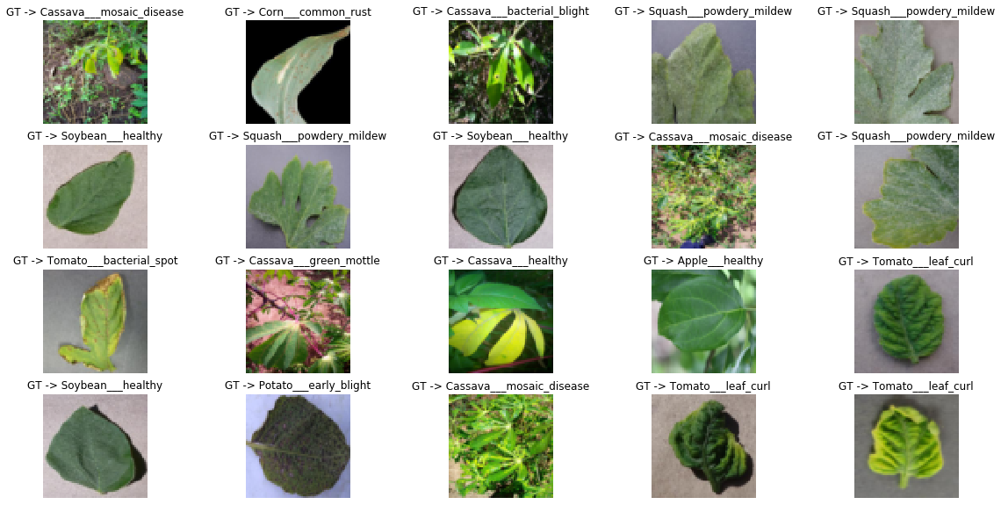
Dataset

Slide 22
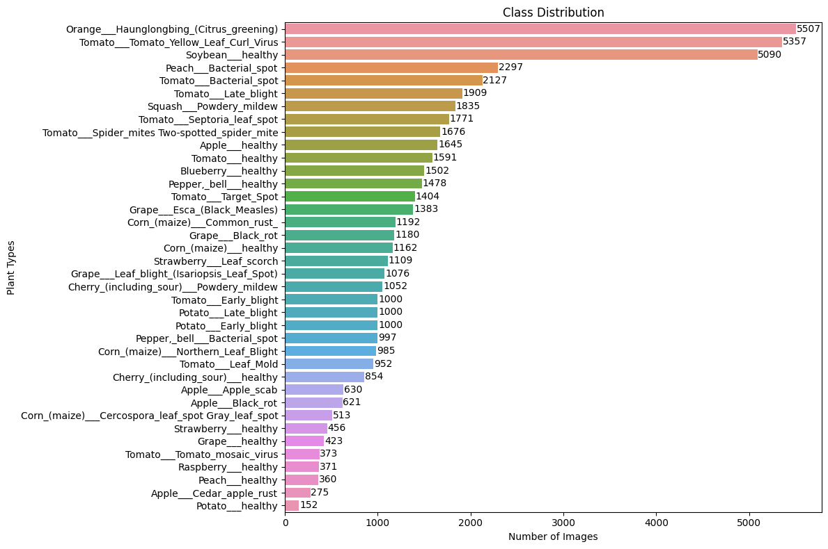
Data Class distribution:

Slide 23
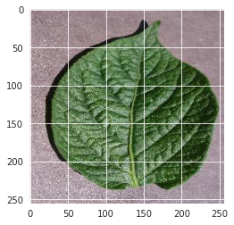
Data Augmentation:
Training dataset: 70% of the images from over 50,000 expertly curated images on healthy and infected leaves of crop plants, available on the PlantVillage platform.
Testing dataset: 30% of the images, also sourced from the PlantVillage platform.
Standardization: Resizing all images to 100x100 pixels to ensure uniformity across the dataset.
Transformation: Gray scaling all images to simplify the data and remove color variation, aiding in the efficiency of machine learning algorithms.

Slide 24
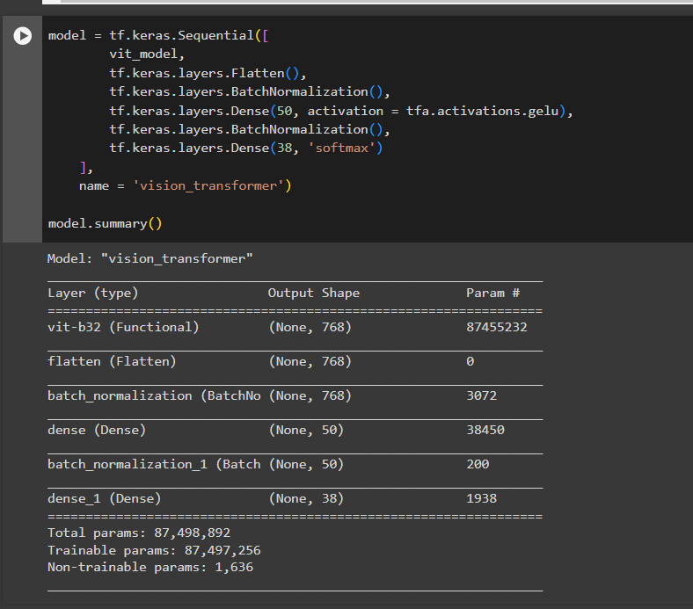
Model Architecture :

Slide 25
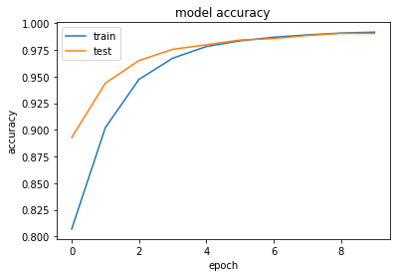
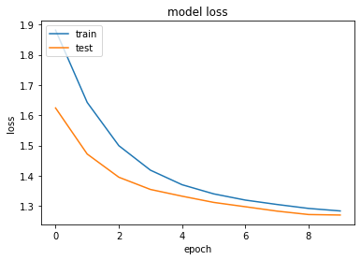
Model Accuracy and losses graph :
Training accuracy: 98.2%
Validation Accuracy: 96.8%

Slide 26
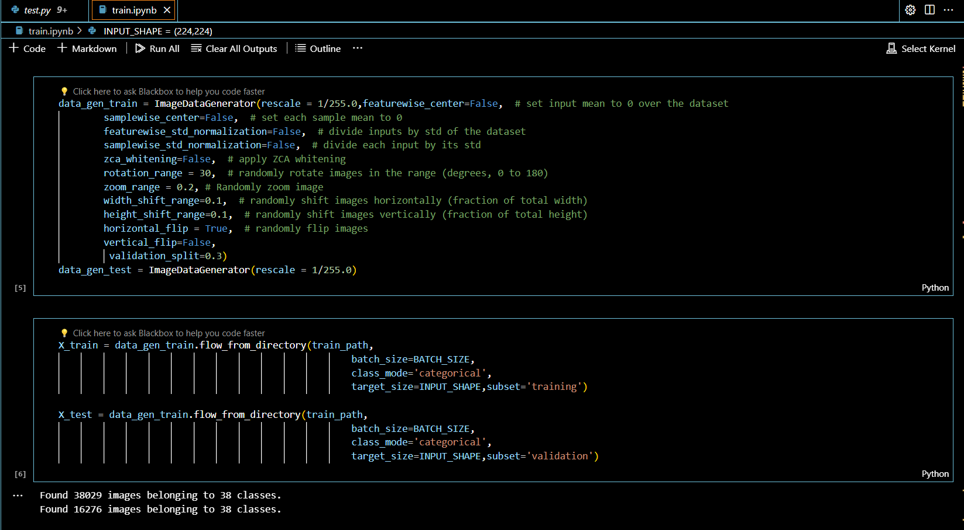
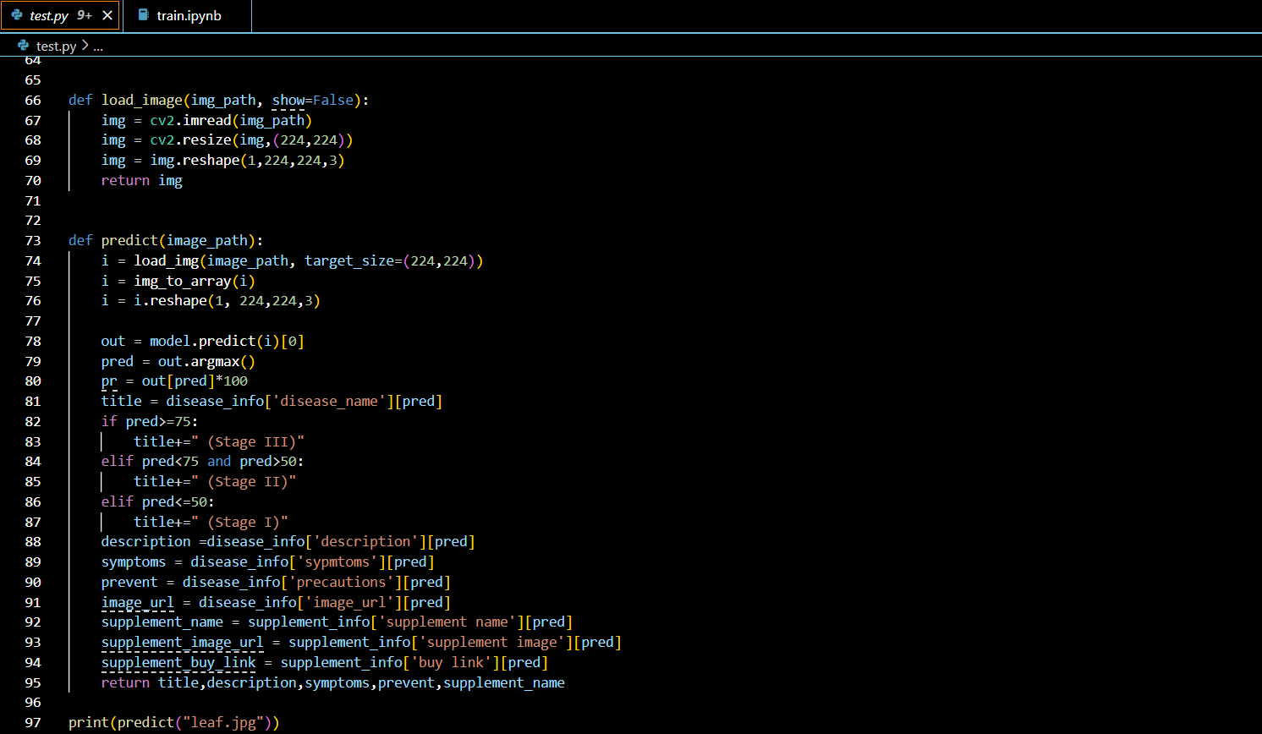
CODE SNIPPET
Training code
Testing code

Slide 27
Diagrams

Slide 28
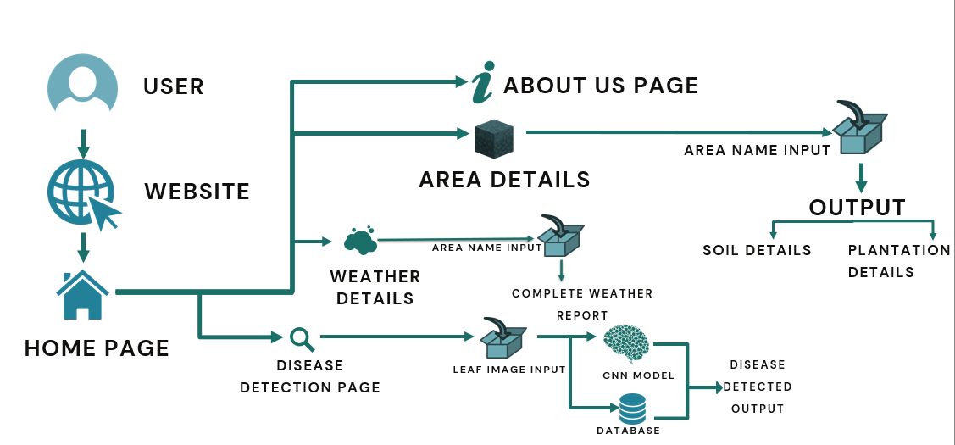
CONCEPTUAL DIAGRAM

Slide 29
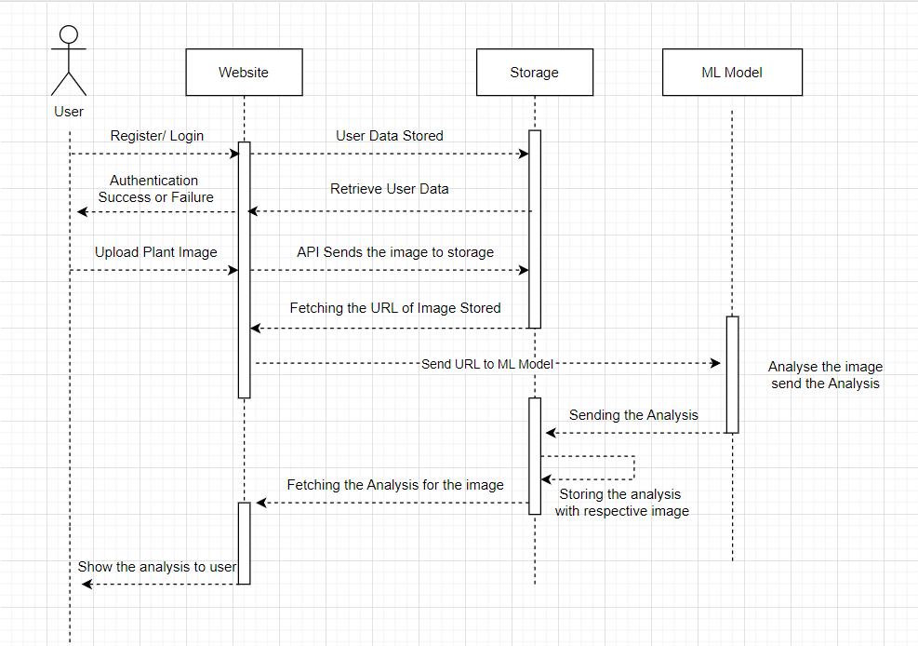
SEQUENCE DIAGRAM

Slide 30
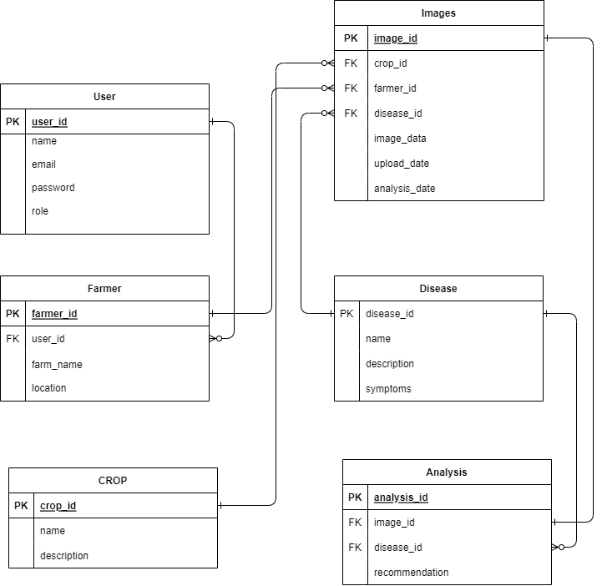
Class Diagram

Slide 31
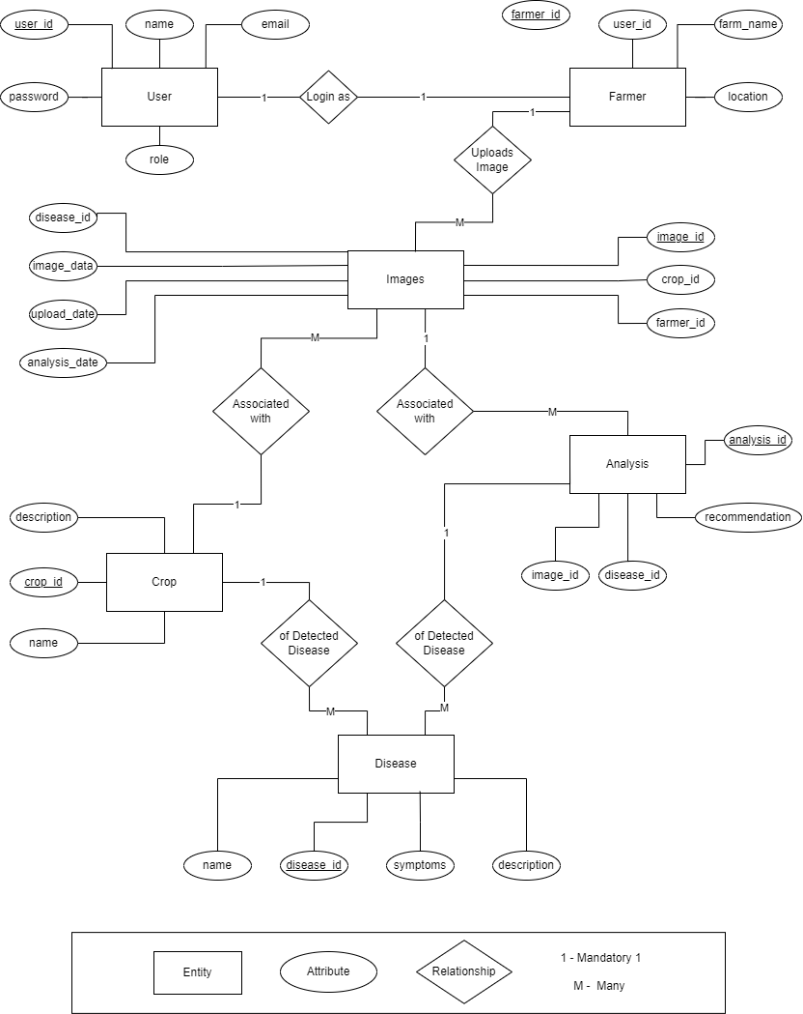
ER Diagram

Slide 32
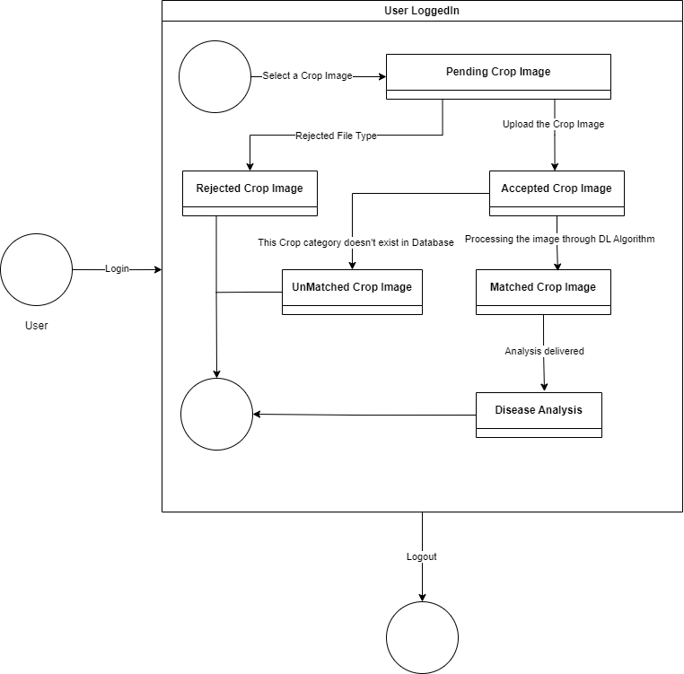
State Diagram

Slide 33
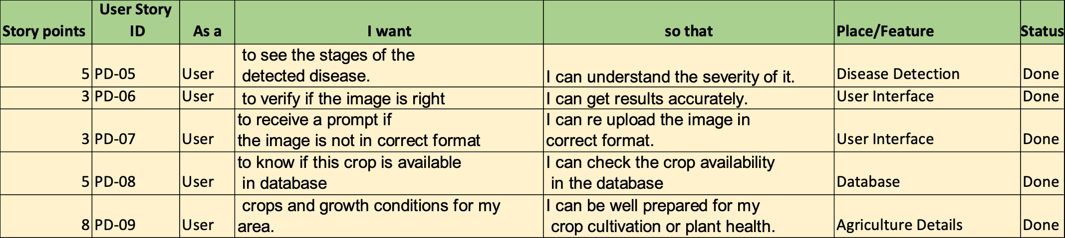
Sprint -3 Recap

Slide 34
PRODUCT BACKLOG

Slide 35
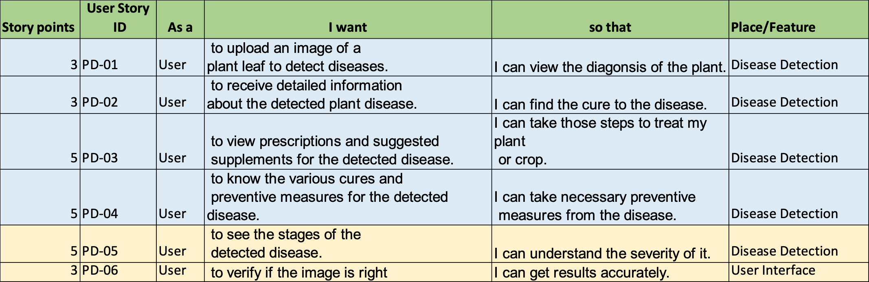
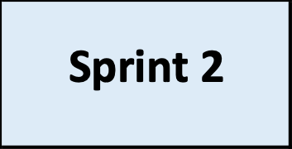
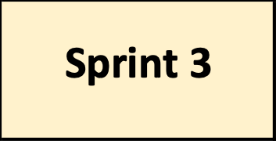
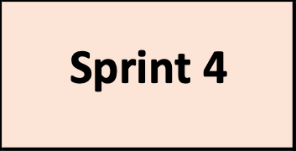
Product Backlog – Sprint 2

Slide 36
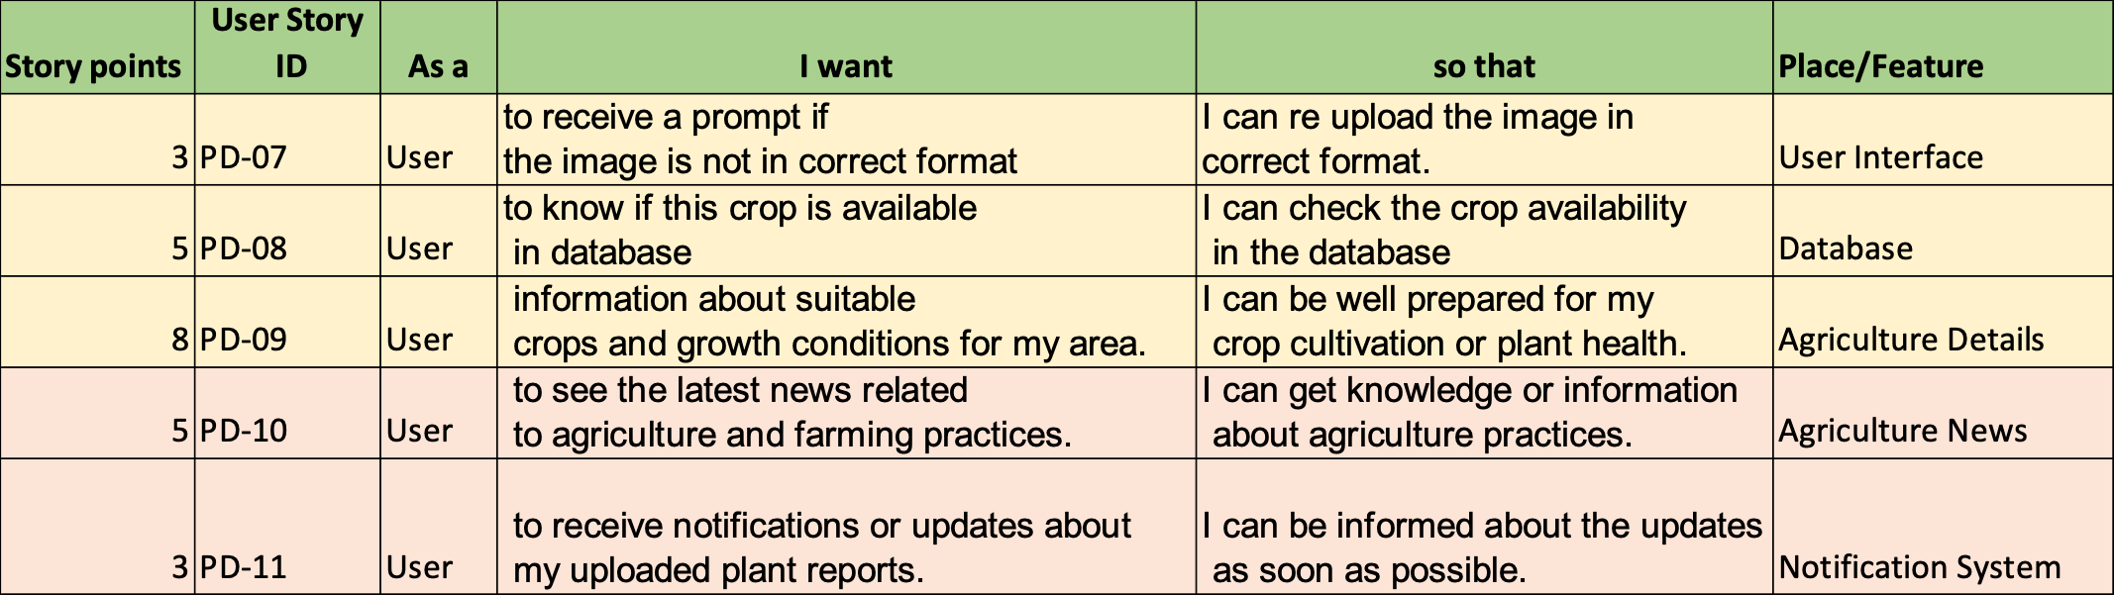
Product Backlog – Sprint 3

Slide 37
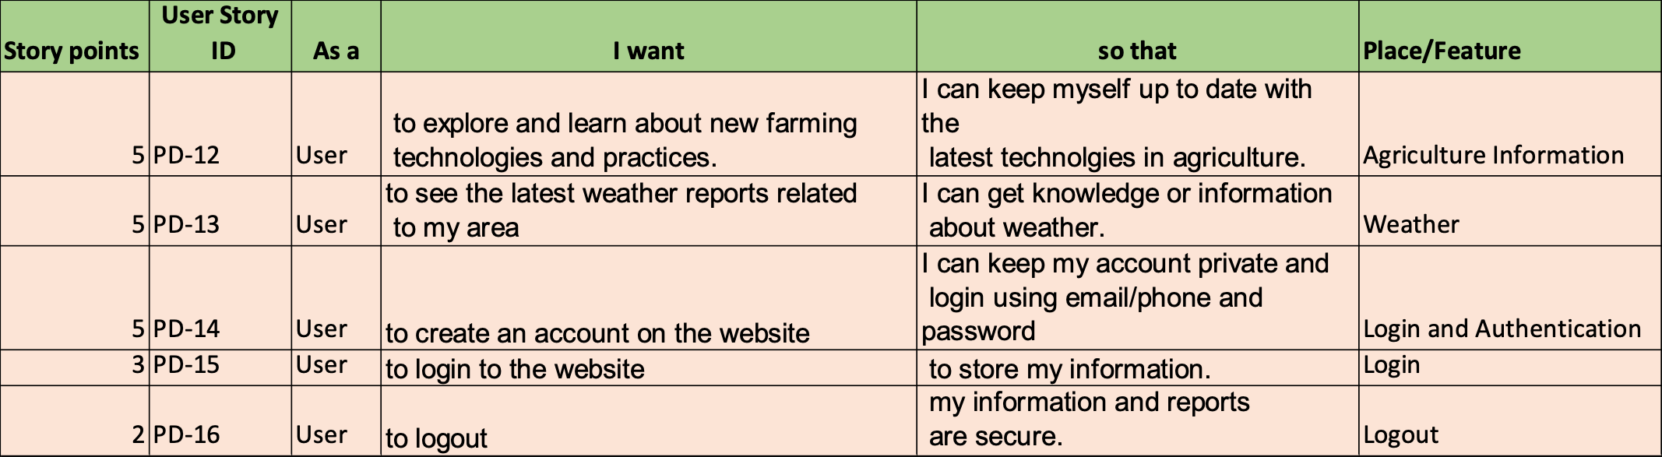
Product Backlog – Sprint 4

Slide 38
User Stories / Acceptance Criteria

Slide 39
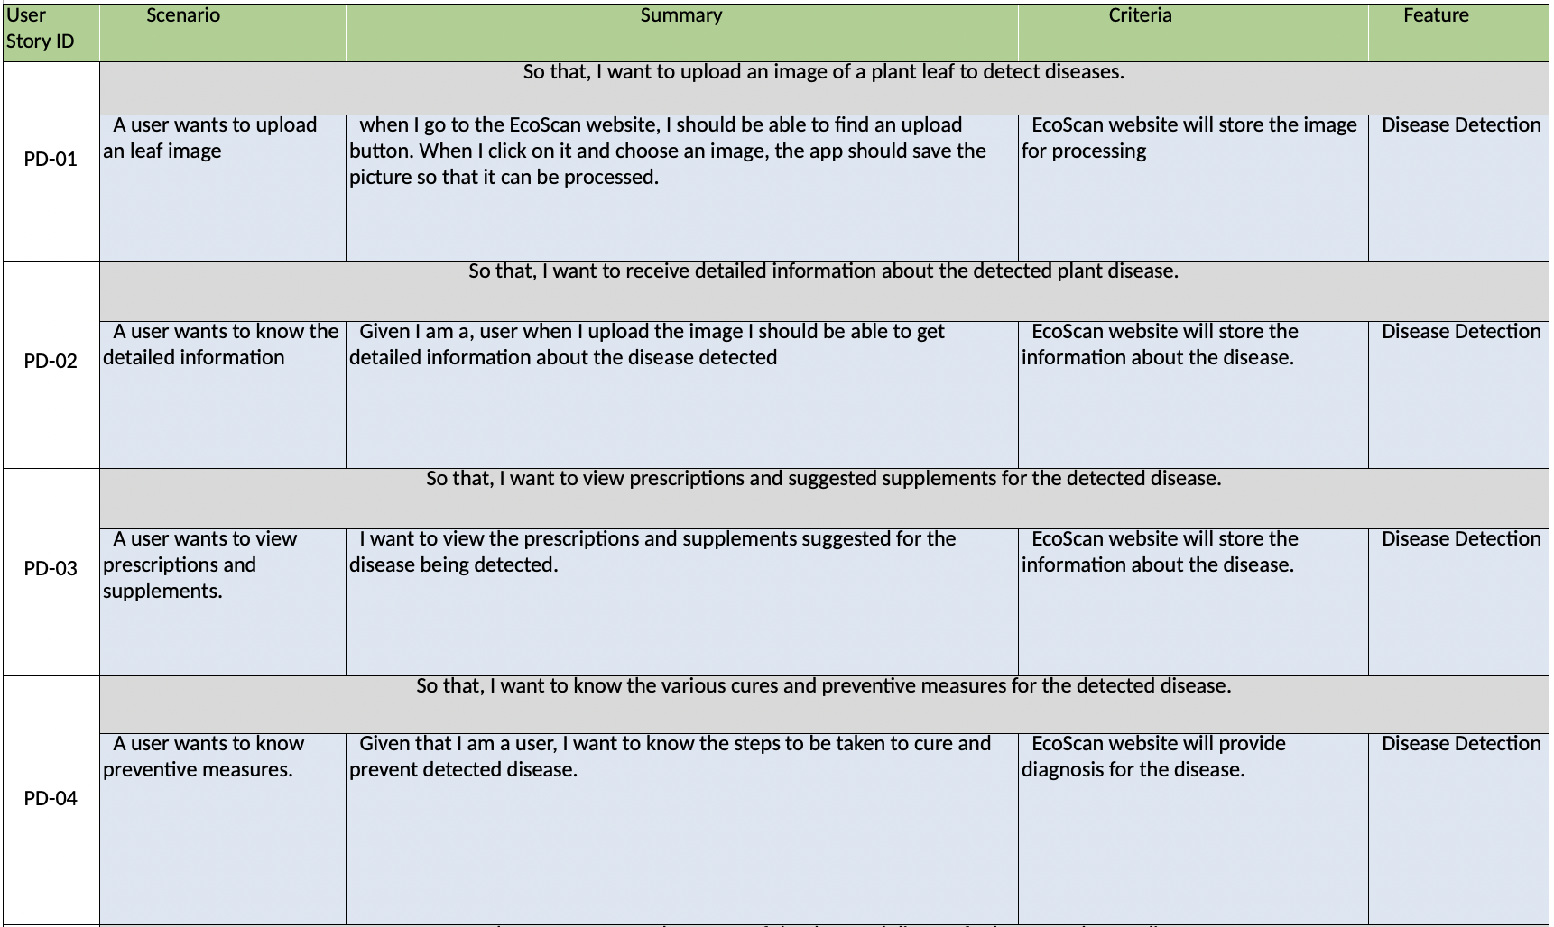
Sprint 2

Slide 40
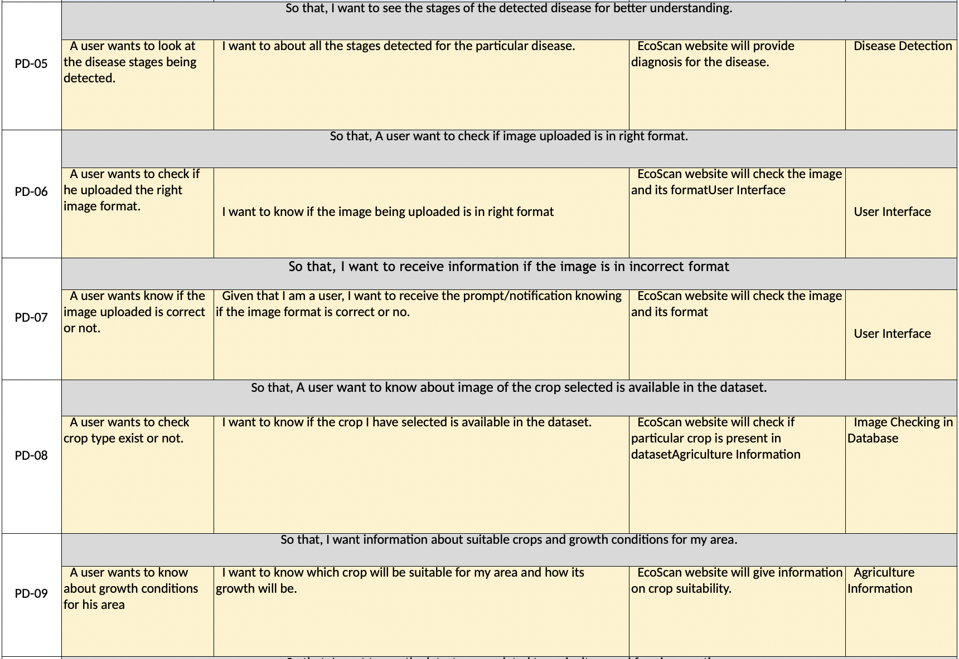
Sprint 3

Slide 41
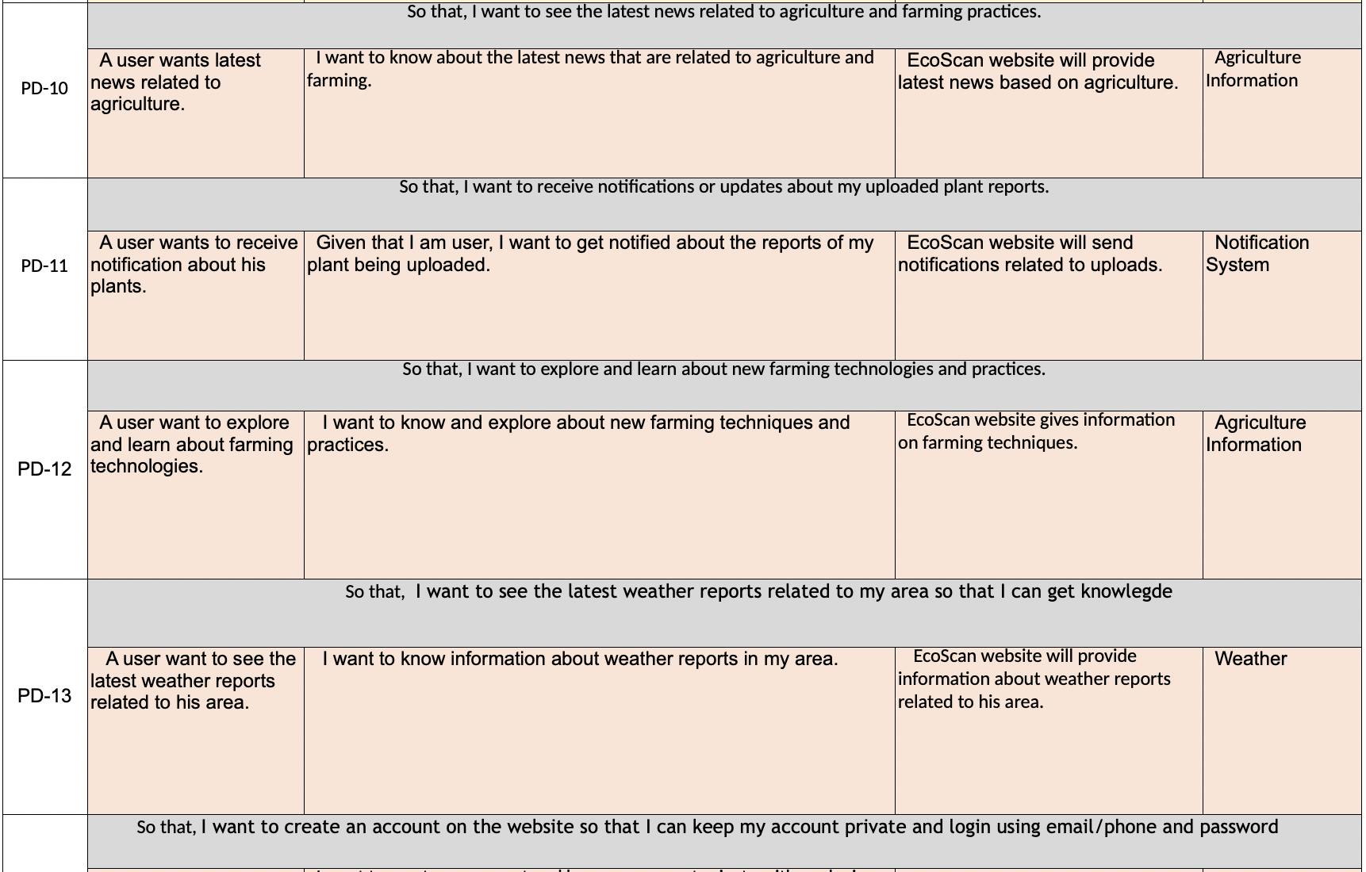
Sprint 4

Slide 42
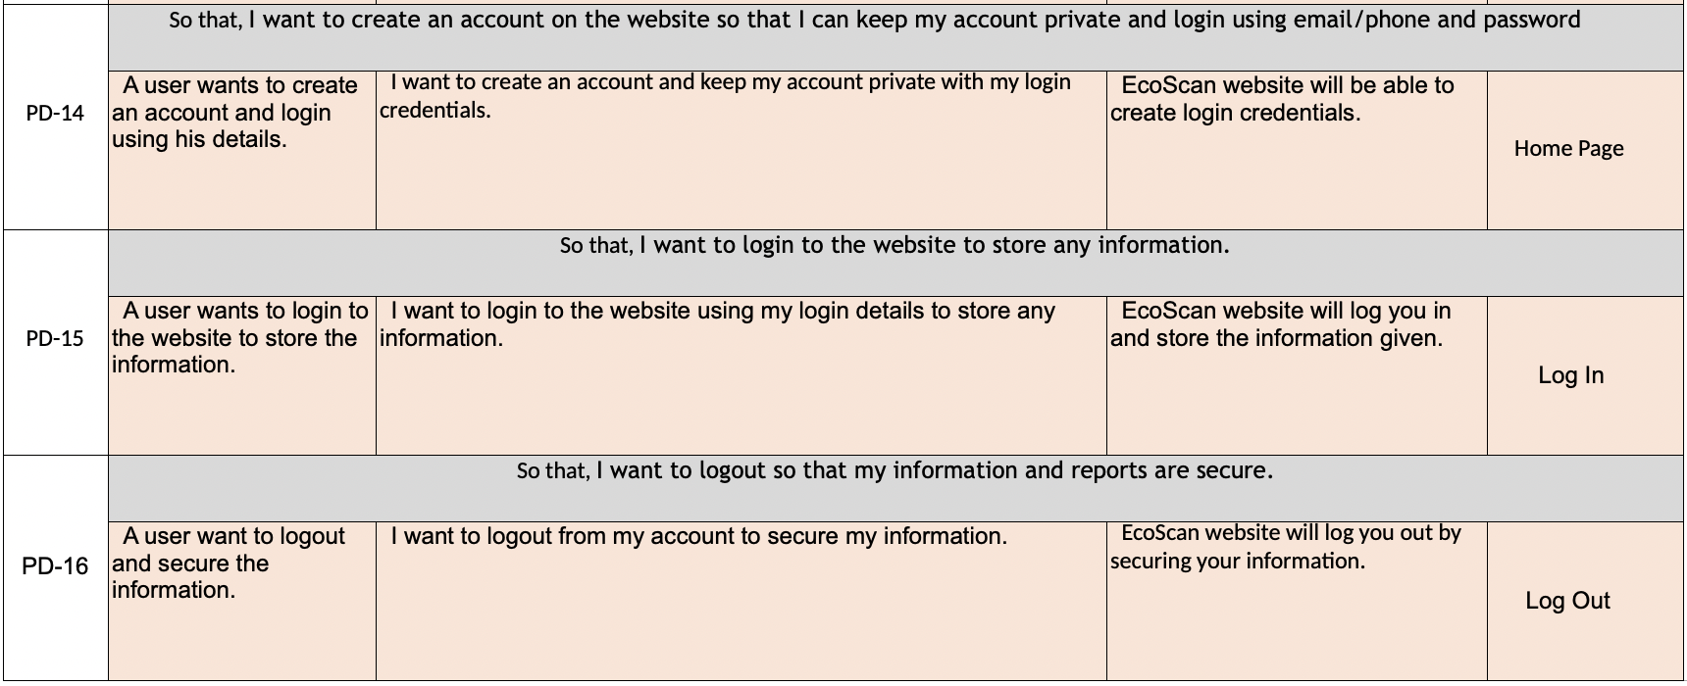
Sprint 4

Slide 43
Sprint Summary

Slide 44
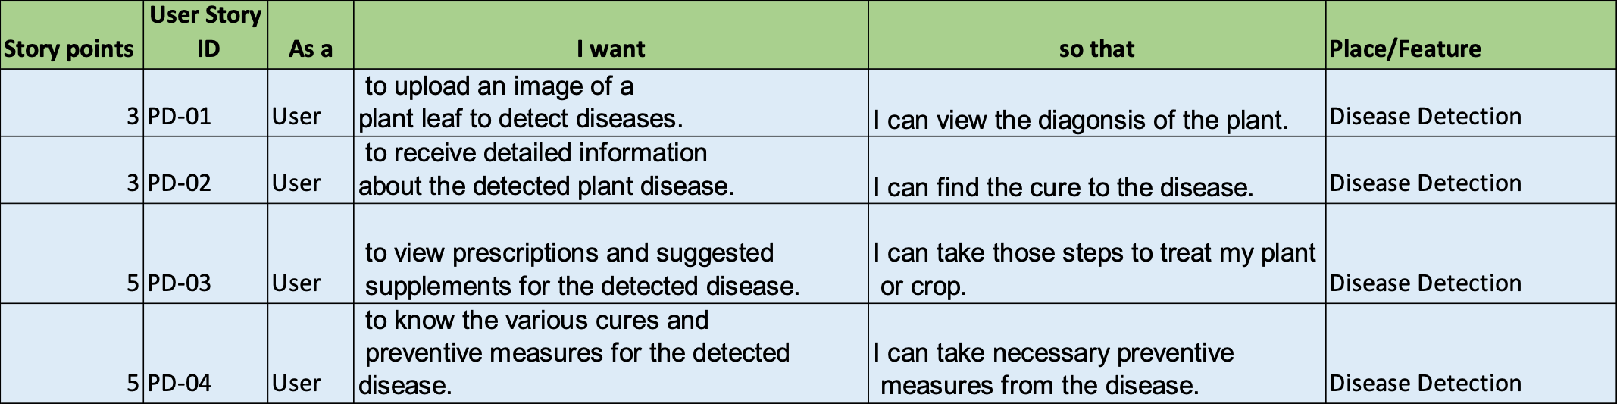
Sprint 2

Slide 45
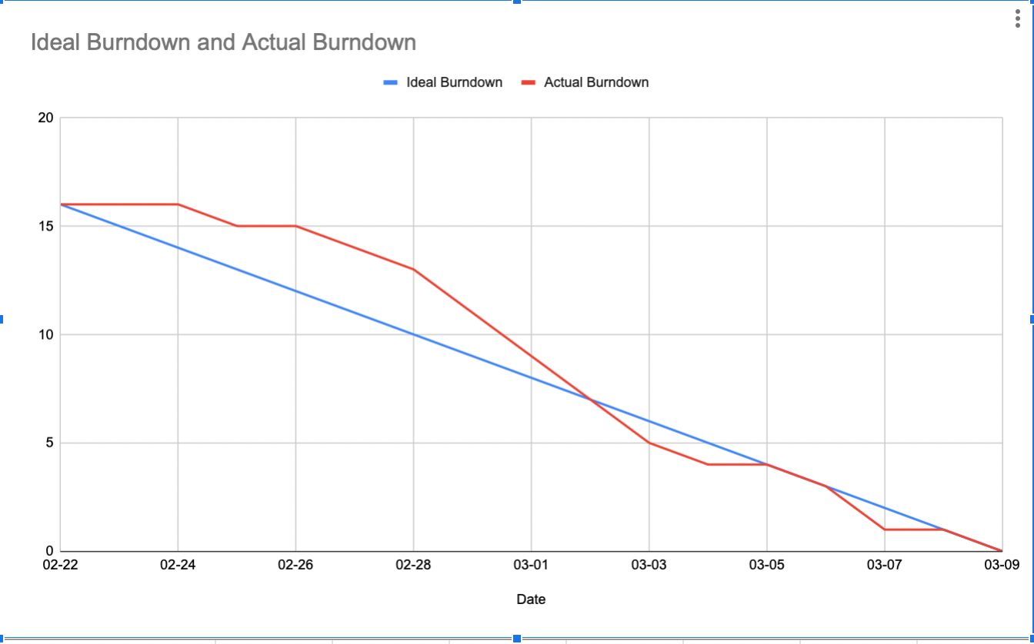
Burn down Chart for Sprint 2

Slide 46
Sprint 3

Slide 47
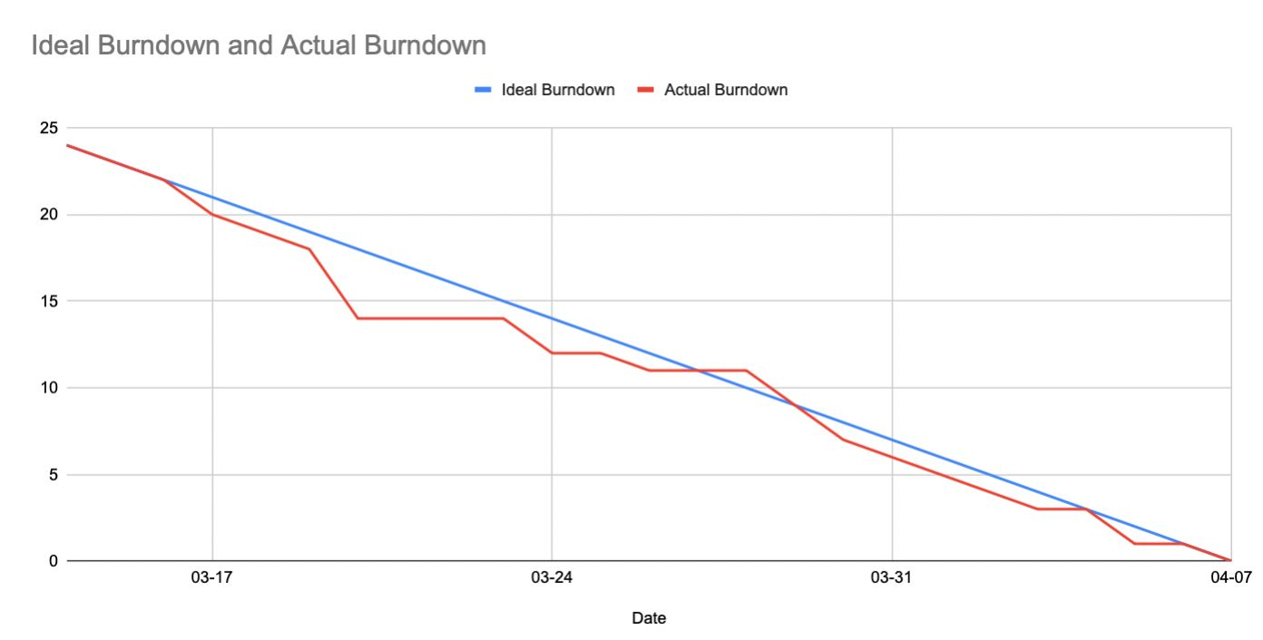
Burn down Chart for Sprint 3

Slide 48
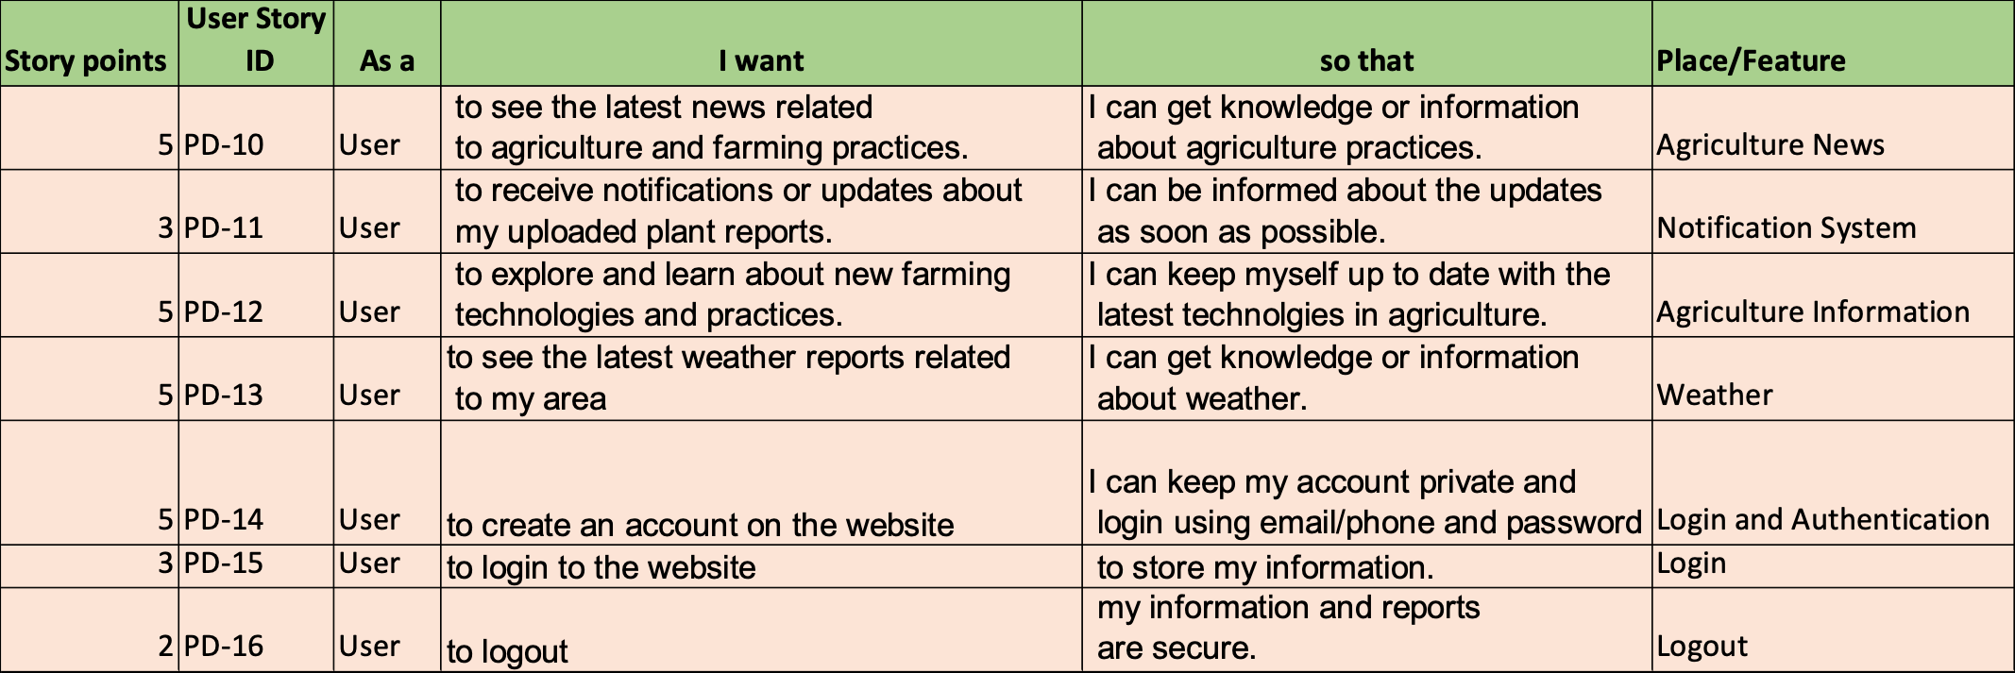
Sprint 4 Backlog

Slide 49
Sprint 4 Stories and Acceptance Criteria

Slide 50
Sprint 4 Stories and Acceptance Criteria

Slide 51
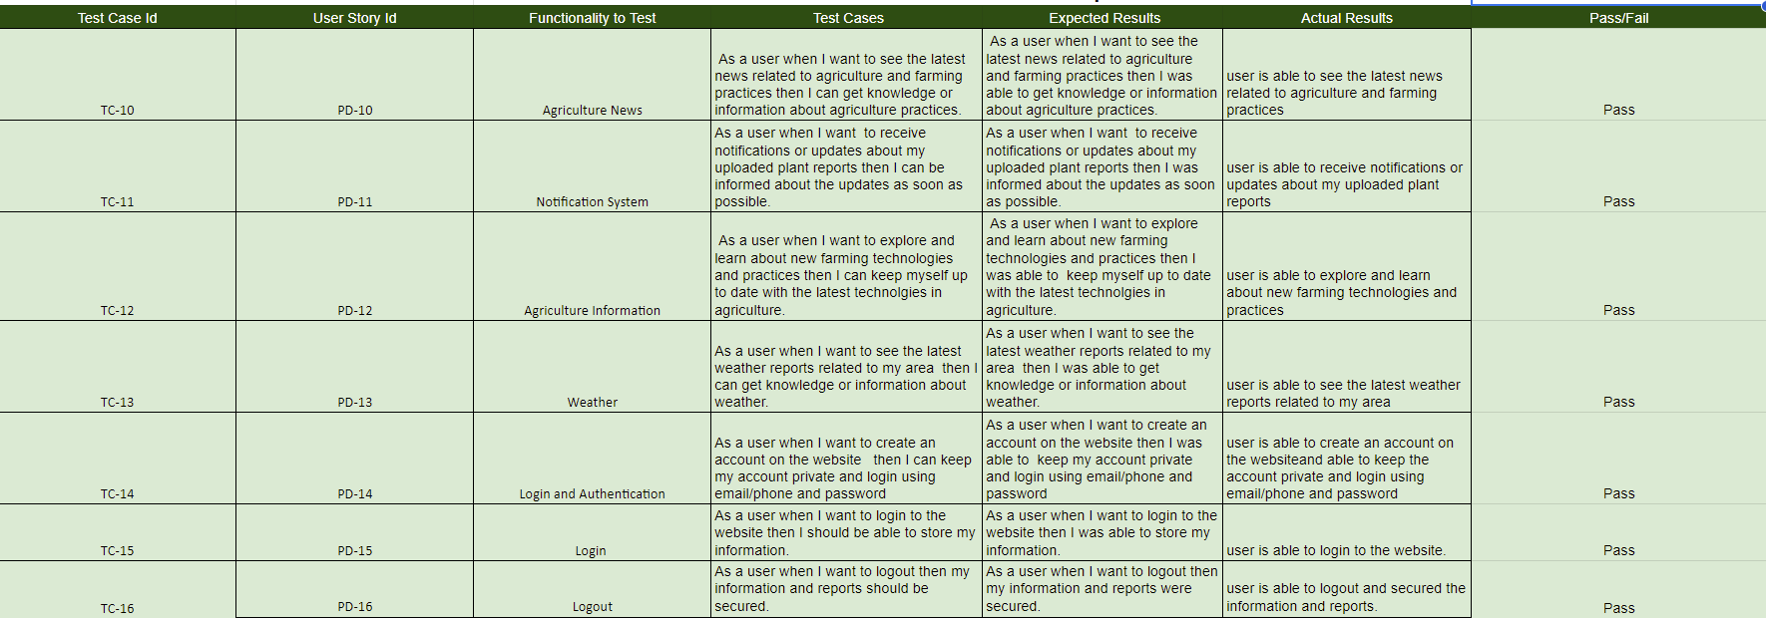
Test Cases

Slide 52
Stories Completed Sprint 4

Slide 53
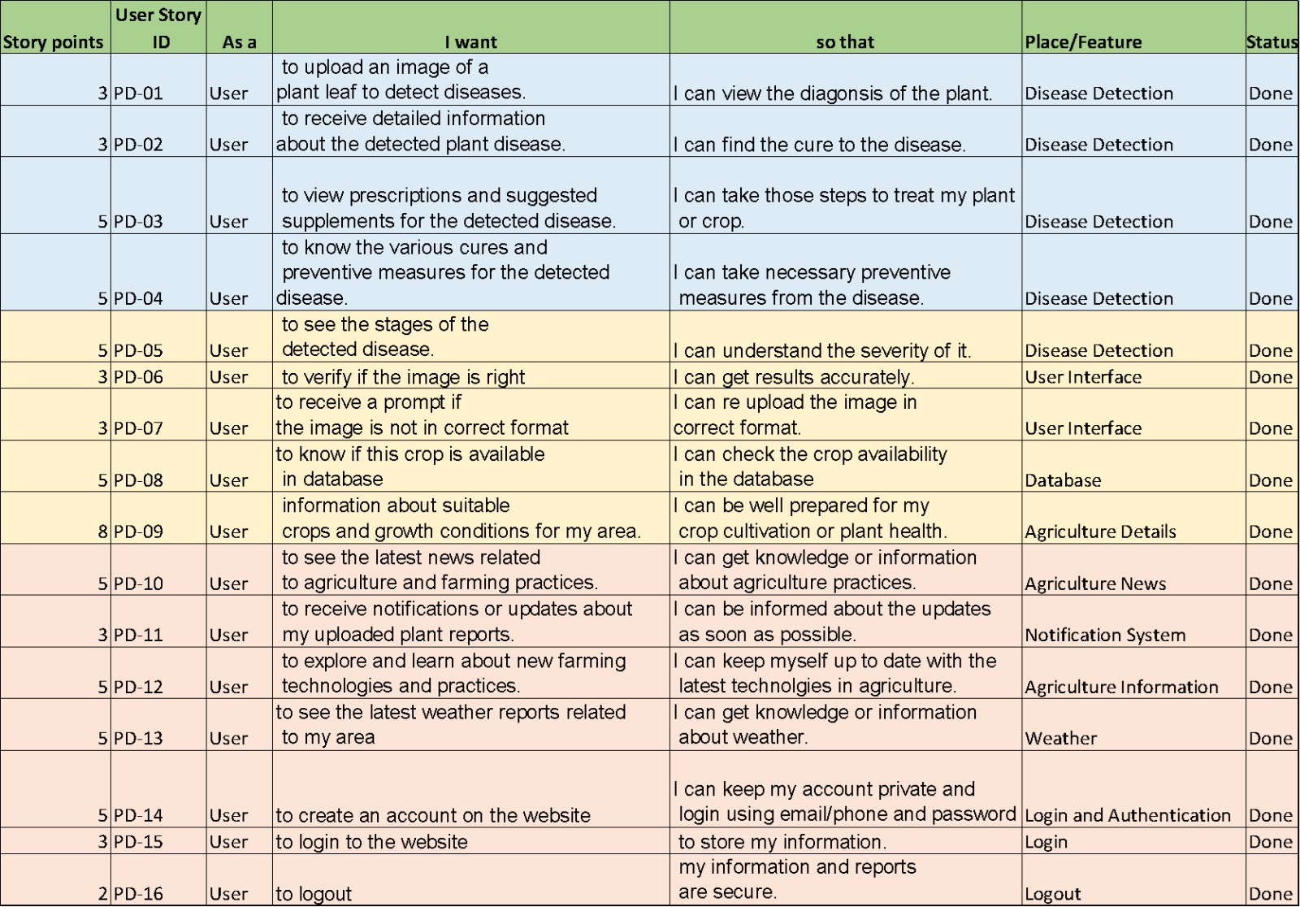
All Stories Completed

Slide 54
Metrices

Slide 55
Team Velocity – Sprint 4
Story Points: 28

Slide 56
Team’s Historical Average

Slide 57
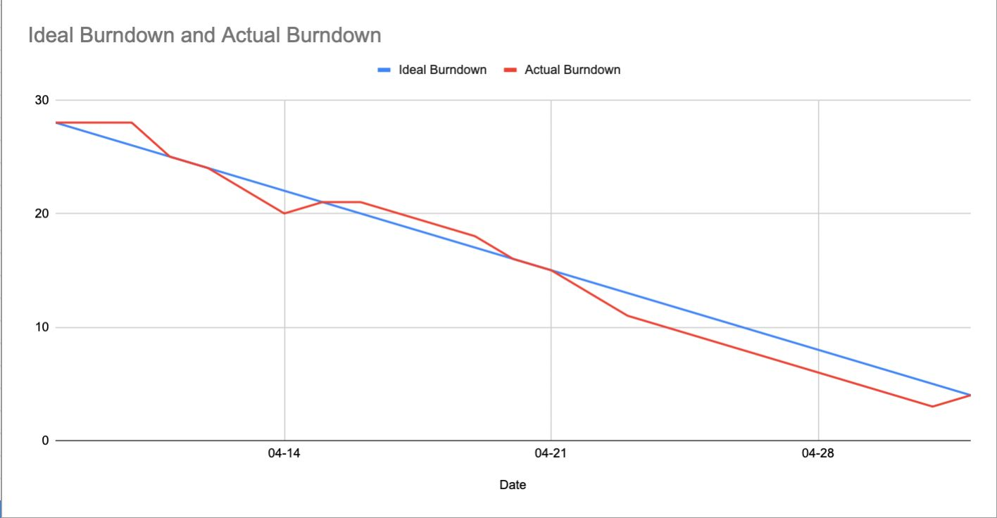
Burn down Chart for Sprint 4

Slide 58
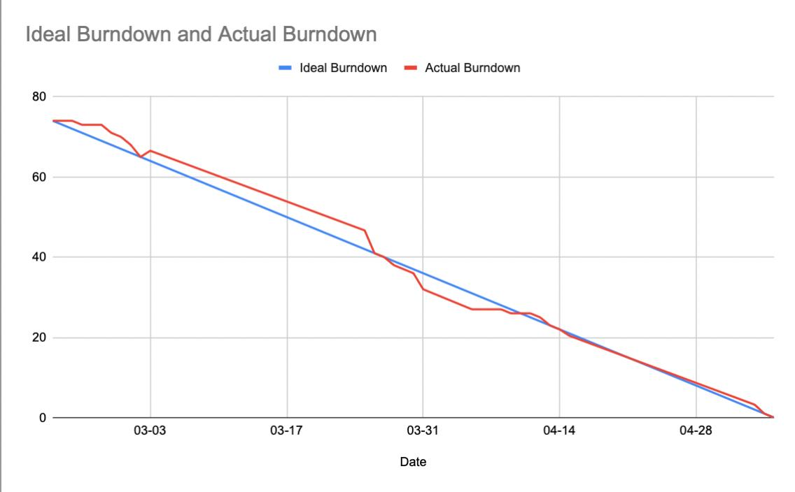
Average Burn Down Chart

Slide 59
Completed Ratio Sprint 4
completed/committed ratio = 28/28, which is 100%

Slide 60
RETROSPECTIVE

Slide 61
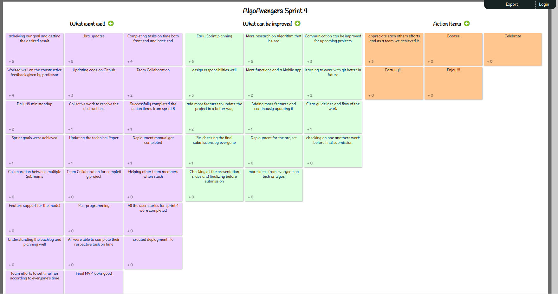
IDEA BOARD

Slide 62

What went well?
Achieving our goal and getting the desired result.
Jira and Git updates.
Completing tasks on time both front end and back end.
Worked well on the constructive feedback given by professor

Slide 63
What can be improved?
Early Sprint planning.
More research on Algorithm that is used.
Communication can be improved for upcoming projects.
assign responsibilities well.

Slide 64
Action Items?
Appreciate each other efforts and as a team we achieved it.
Celebrate.
Party!

Slide 65
PROJECT DEMO

Slide 66
Demo
https://www.youtube.com/watch?v=JHux9wG7uYs&ab_channel=niyatighagada

Slide 67
App screenshots

Slide 68
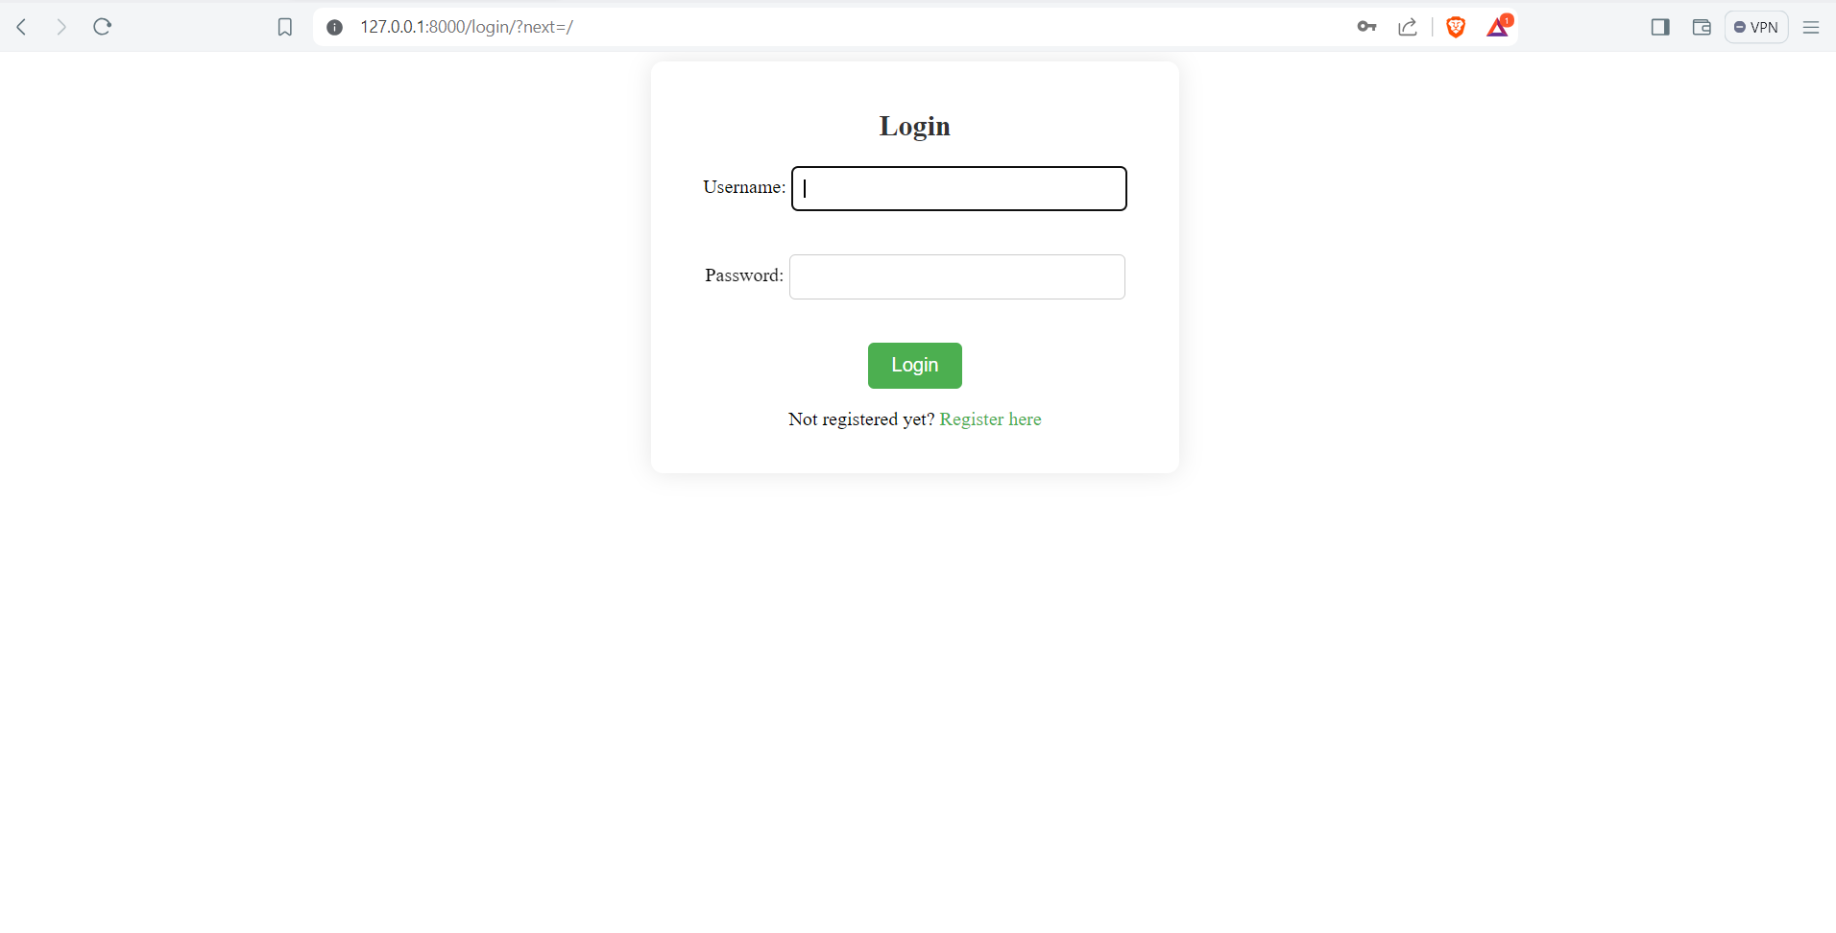
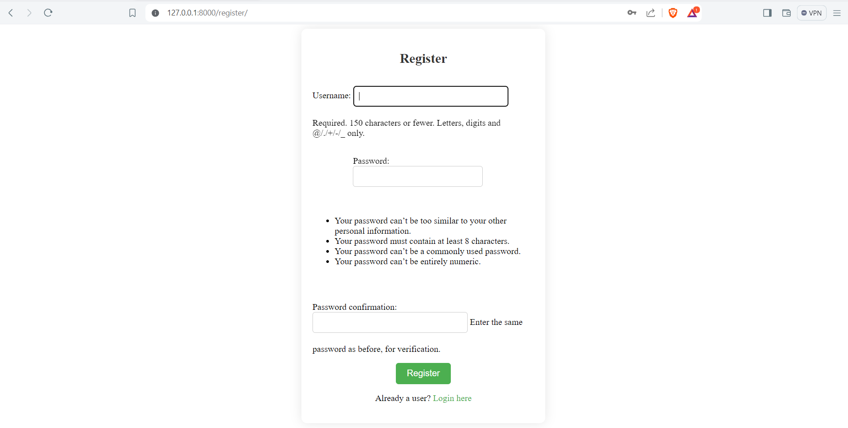
APPLICATION SCREENSHOT

Slide 69

APPLICATION SCREENSHOT

Slide 70

APPLICATION SCREENSHOT

Slide 71

APPLICATION SCREENSHOT

Slide 72

APPLICATION SCREENSHOT

Slide 73

APPLICATION SCREENSHOT

Slide 74

APPLICATION SCREENSHOT

Slide 75

APPLICATION SCREENSHOT

Slide 76

APPLICATION SCREENSHOT

Slide 77
Slides for API
Agriculture News API
Purpose: Keeps users informed with the latest developments in agriculture.
Features: Real-time news updates. Comprehensive coverage of agricultural trends, technology, and markets.
Benefits: Supports informed decision-making for farmers and agribusinesses. Encourages continuous learning and industry awareness.
Weather Forecasting API
Purpose: Provides accurate and timely weather forecasts.
Features: Localized weather predictions. Alerts for severe weather conditions.
Benefits: Aids in planning agricultural activities. Minimizes weather-related risks and losses.
Authorization Page API
Purpose: Secures user access and enhances website security.
Features: User authentication and authorization. Role-based access control.
Benefits: Protects sensitive user data. Ensures a safe and trustworthy platform for users.

Slide 78
GitHub Link
https://github.com/htmw/2024S-AlgoAvengers

Slide 79

Technical Paper

Slide 80


THANK YOU

